Slide 1







December 4th, 2020
PM: Hunter
Frontend: Neha, Maria, Jody, Yao Dong, Annie, Alexia, Nicholas, Enzhe
Backend: Hunter, Tyler
Notes:
Presenter: Hunter
Hello everyone! We are Poll Buddy. I’m Hunter, the project manager, and I’m going to start us off by giving an overview of our app and how we’re developing it, and later you’ll hear from the other Poll Buddies some in depth details about the different portions of the project.

Slide 2
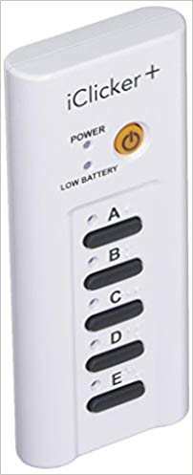
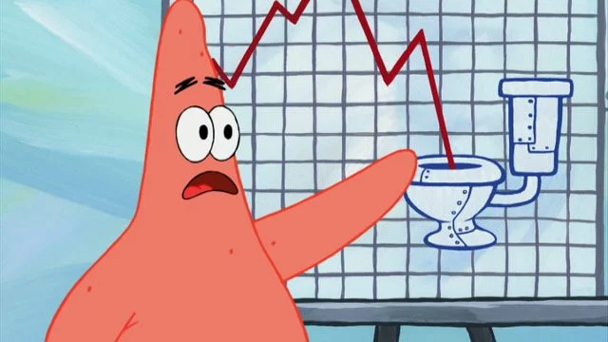
What is Poll Buddy?
Website alternative to iClickers
Virtual polling system
Affordable, easy to use, and interactive
Powerful views for everyone
Integratable with Submitty and other RPI platforms
Notes:
Presenter: Hunter
So jumping right in, what is Poll Buddy? As a quick overview, Poll Buddy is a website alternative to iClickers. iClickers are classroom tools used to get responses from students, but they have some major limitations. We’re building a virtual polling system that’s affordable, easy to use, and interactive for all types of users. We also aim to integrate with other RPI platforms like Submitty and CAS for things like easy automatic grading and simple sign in. RPI login has recently been added and Submitty integration is hopefully coming next semester.

Slide 3
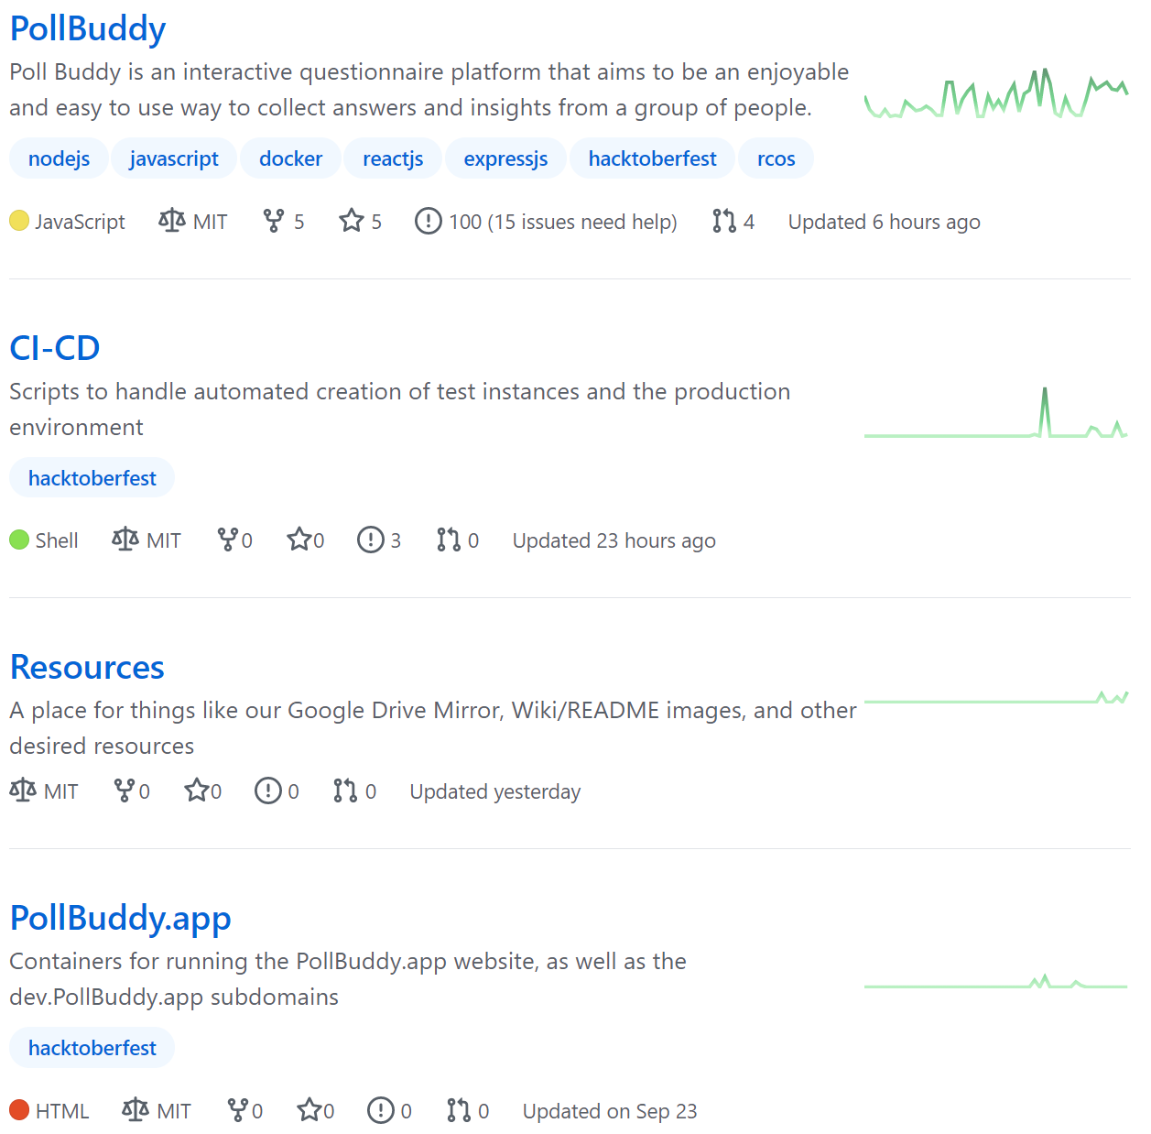
Poll Buddy Info
Time Goal of the Project: Demo now!
Beta Product: Spring 2021
Repos: https://github.com/PollBuddy
Licenses: MIT
Contributors: Anyone can access the repos.
Poll Buddy members can work directly with the repo through branches and pull requests. Outside contributors can fork and PR.
Github issue list gives potential tasks to work on. We also now have a Contribution Guide and Wiki with ever expanding documentation.
Notes:
Presenter: Hunter
We’ve been working on Poll Buddy for 4 semesters now and are finally ready to do a live demo! More on that later. Next, we’re hoping to do beta testing in RCOS next semester (similar to how Venue is being used now), and use feedback from that to finish preparations for a wider rollout. We’ve made a ton of progress over the semesters and we’re fairly proud of how it’s turning out.
On this slide, I’ve linked our Github Organization page that contains the 4 repos we now have, and their licenses. As for contributors, everything is open source and we have recently started a wiki with a contribution guide and other details about the app to aid in development and understanding how the app works.

Slide 4
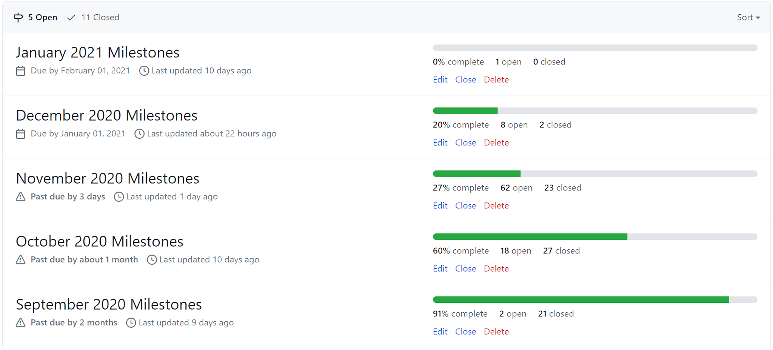
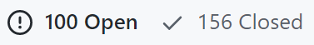
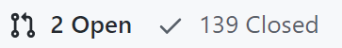
Managing the Project
Milestones were broken down into months and issues per month.
Issues used as trackers for todo items. Labeled frontend / backend / other tags as relevant.
Notes:
Presenter: Hunter
We track to-do items through Github Issues, and link them to Milestones to group them by month to try to keep on a schedule. We do our best to stick to the milestones, but they end up being more of suggestions as to what to do soonest rather than rigid guidelines. This semester, we greatly expanded the use of issues by just making a lot more of them and adding more details within to help aid everyone in knowing what needs to be done.

Slide 5
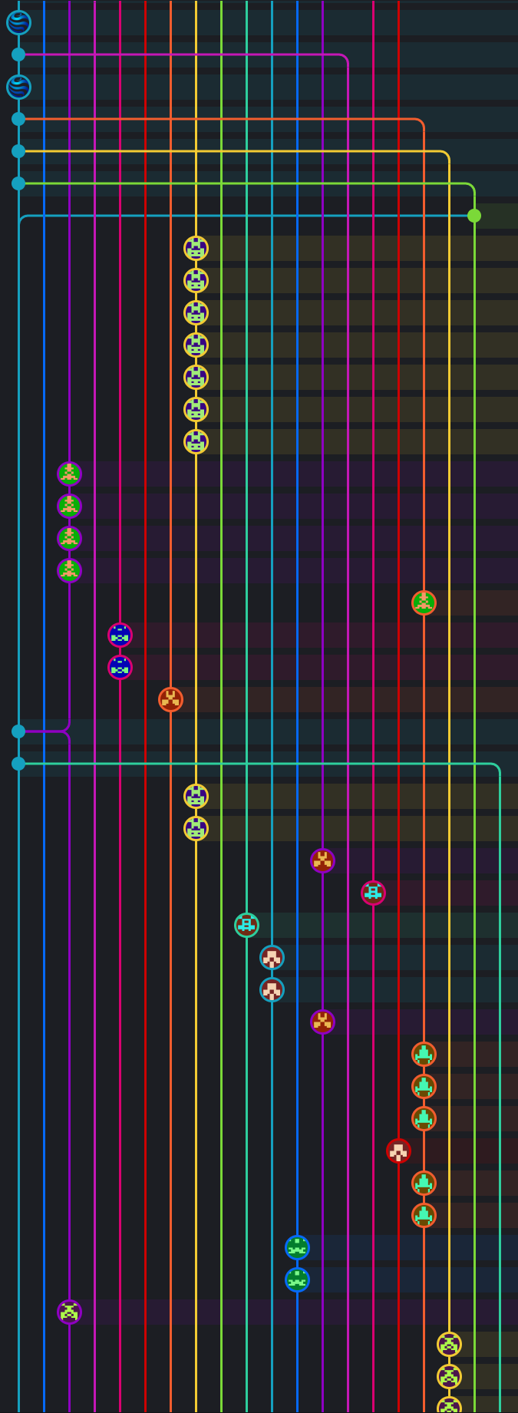
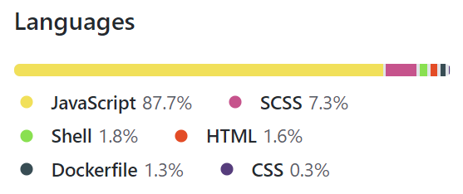
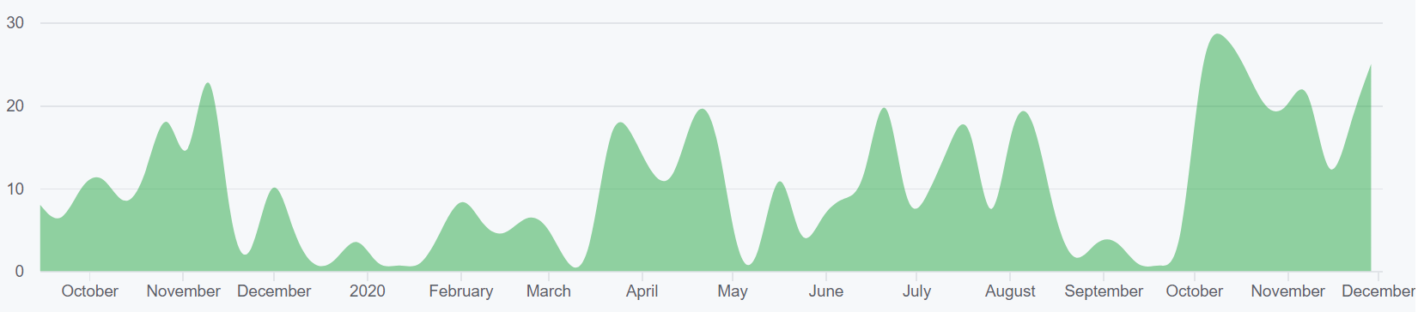
Repo Stats
902 total commits to master (as of 12/03/2020)
Contributions to master, excluding merge commits:
Notes:
Presenter: Hunter
Here are some basic stats about the main repo. We’ve had a fantastic amount of commits this semester again, this time adding a little over 350 commits to the main repo, and around 20 to the other repos. Here’s some figures showing what the most used languages are at the top, the frequency of commits at the bottom, and the fun intermingling of branches on the right when development is at peak speed.

Slide 6
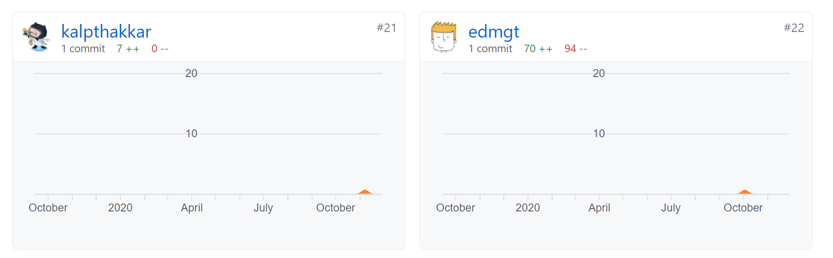
Outside RCOS
2 new outside contributors!
“Good First Issue” tag gets us on a few sites like:
https://goodfirstissues.com
https://goodfirstissue.dev
Notes:
Presenter: Hunter
This semester, we actually even got contributions from outside RCOS. It was definitely neat to see contributions from the outside world as I feel it really strengthens the “open source” part of RCOS. Based on Github Insights, it looks like these commits came from people who use “good first issue” sites that aggregate repos with issues tagged “good first issue” and suggest them to people looking to get started with Github and development as a whole. We’re hoping to expand the use of the “good first issue” tag for this reason, and it helps our own new members when they’re getting started as well.

Slide 7
Demo
You can try out Poll Buddy right now!
Try out a poll! https://pollbuddy.app/polls/5fc86a9974b9fa7c7b88d2ee/view
Or at the short link: https://tinyurl.com/pollbuddydemo
Other pages and features you’ll see in later slides are live and you can check them out with links on each slide!
Notes:
Presenter: Hunter
And lastly before we get into the frontend and backend details, you can actually try out Poll Buddy right now! Visit the link you see on the slide (or posted in the Webex chat) and you can submit to a real poll! I also included an external short link as we don’t have that functionality yet and the URL is a bit long without it. After this slide, we’ll start getting into some individual contributions and many of those will also have live page links that you can visit and see for yourself if you’d like. The slides have been posted in the RCOS slides channel as well for easy link clicking. Be warned though that there’s a lot of website things that are still a work in progress, so you’ll probably run into something that doesn’t work right if you go poking around, but you shouldn’t be able to break anything at least, so have fun.

Slide 8
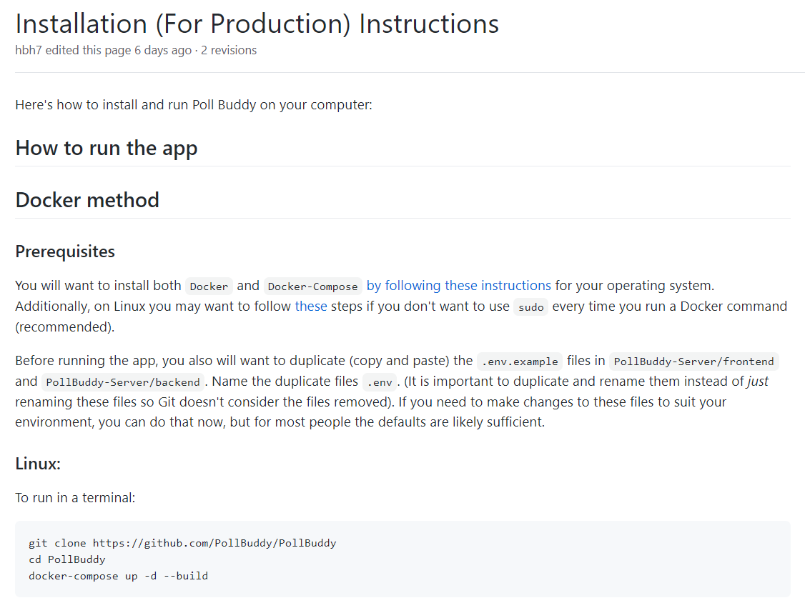
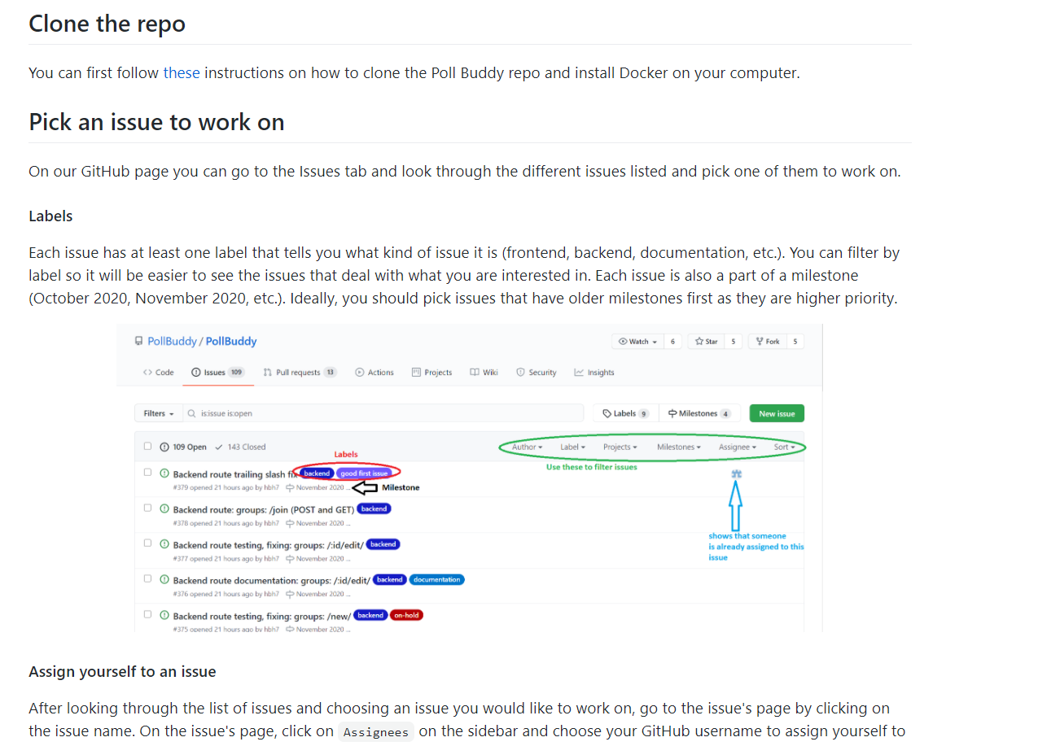
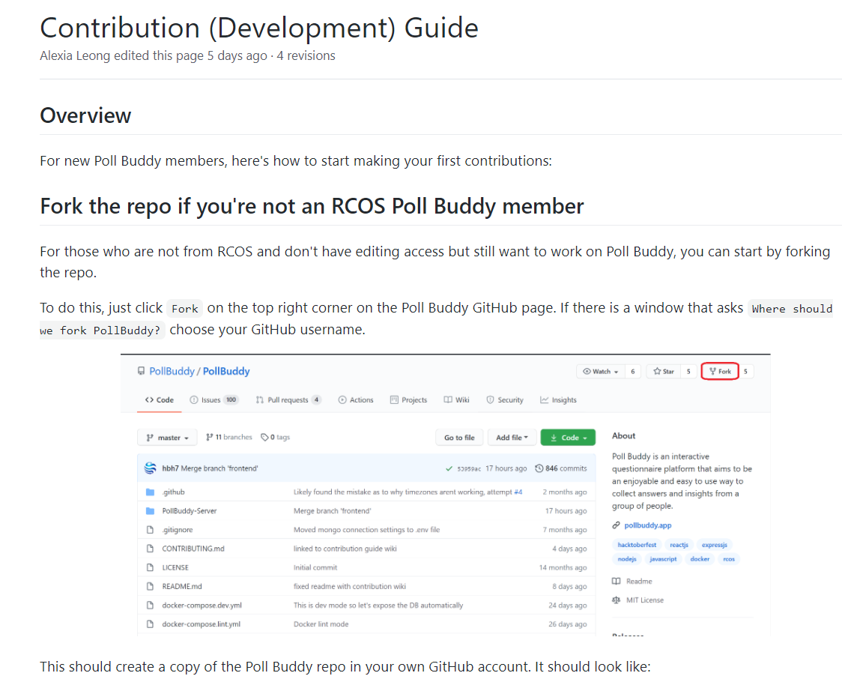
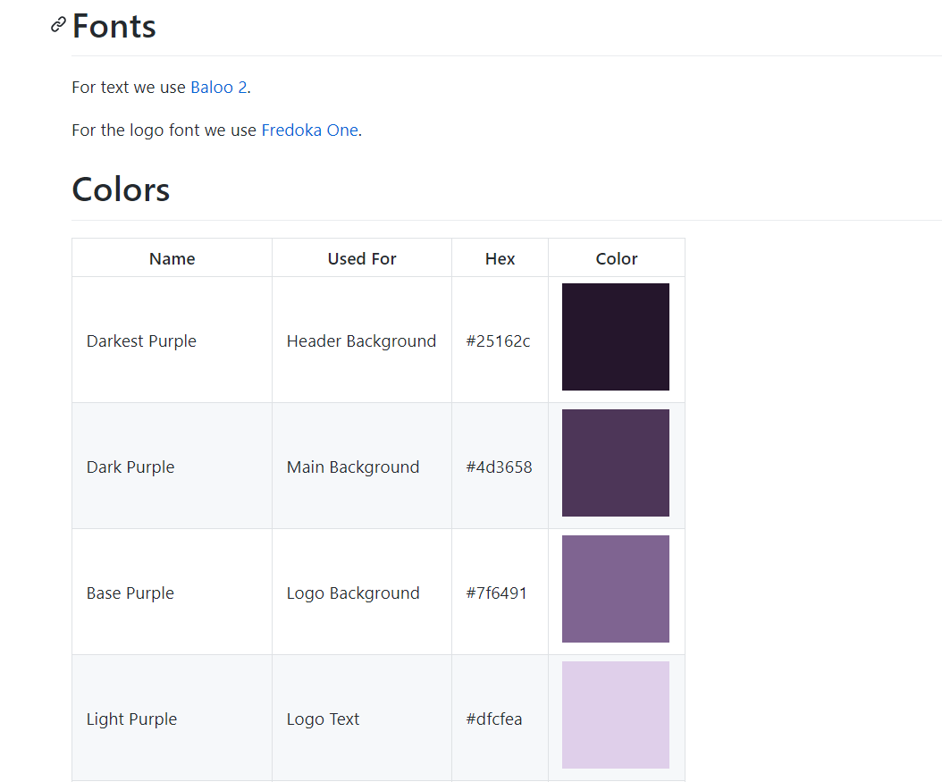
Wiki
This semester we added a lot to our Wiki to help new and current members
Installation Instructions
Contribution guide
Style guide
Notes:
Hunter: That’s all for me, now I’ll pass it off to Alexia to talk about the Wiki.
Presenter: Alexia
This semester we started to make use of our Wiki. I made the Wiki pages for how to install and run Poll Buddy, a page for new members on how they can start making contributions, and a style guide. These pages are basically here to help new members get started and describes how the repo works and is organized. An issue I had when I first joined Poll Buddy was that I was just confused on what to do and how to start so I made these to help new members less confused so they can start making contributions earlier. I tried to put a lot of detail on the pages and I added images with labels on them so they are easy to follow.

Slide 9
Front End
Notes:
Presenter: Neha
Hi I’m Neha and I’ll be going over the frontend part of the app.

Slide 10

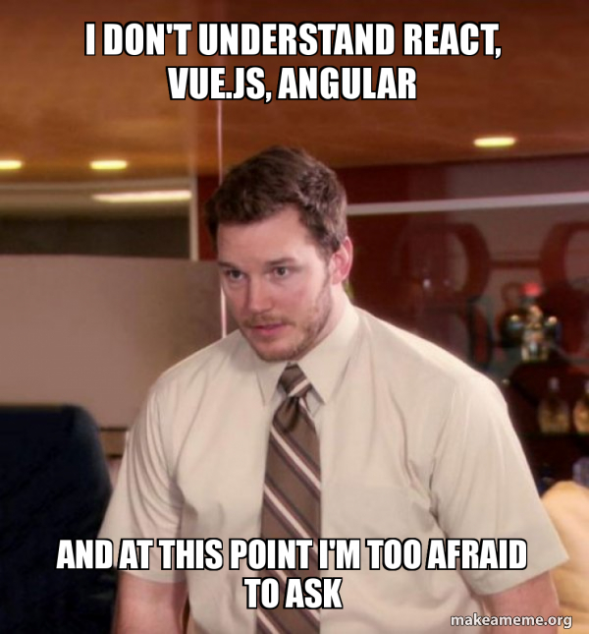

Frontend Framework
REACT!
Notes:
Presenter: Neha
We use React as the framework for Poll Buddy because it allows for efficient code reuse. We also use React Bootstrap which is a library of pre made components like buttons and graphs which look really nice and save us work on css styling.

Slide 11
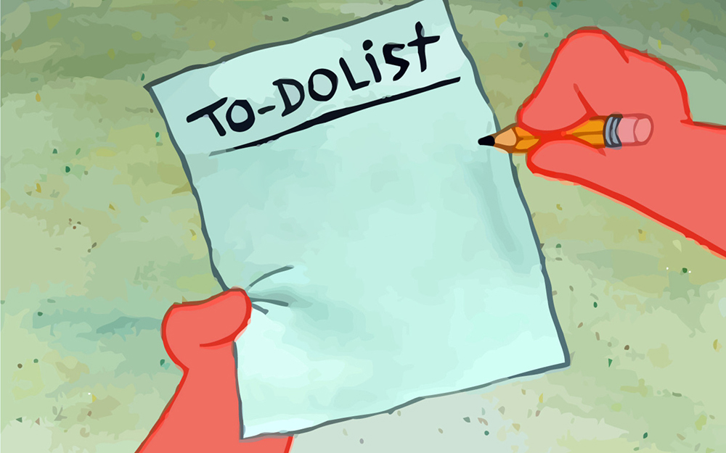
Frontend Tasks
Completed:
Page styling refinement and consistency fixes
Dynamic functionality
Creating all pages defined in the initial sitemap
Code quality fixes
In Progress:
Backend integration
Early testing
Poll
Buddy
Everything else
Notes:
Presenter: Neha
We’ve made quite some progress this semester in order to reach our goals from the proposal, mostly the things you can see on this slide. We still have some things we need to do during the rest of the semester, but we’ve made a lot of progress until now.

Slide 12
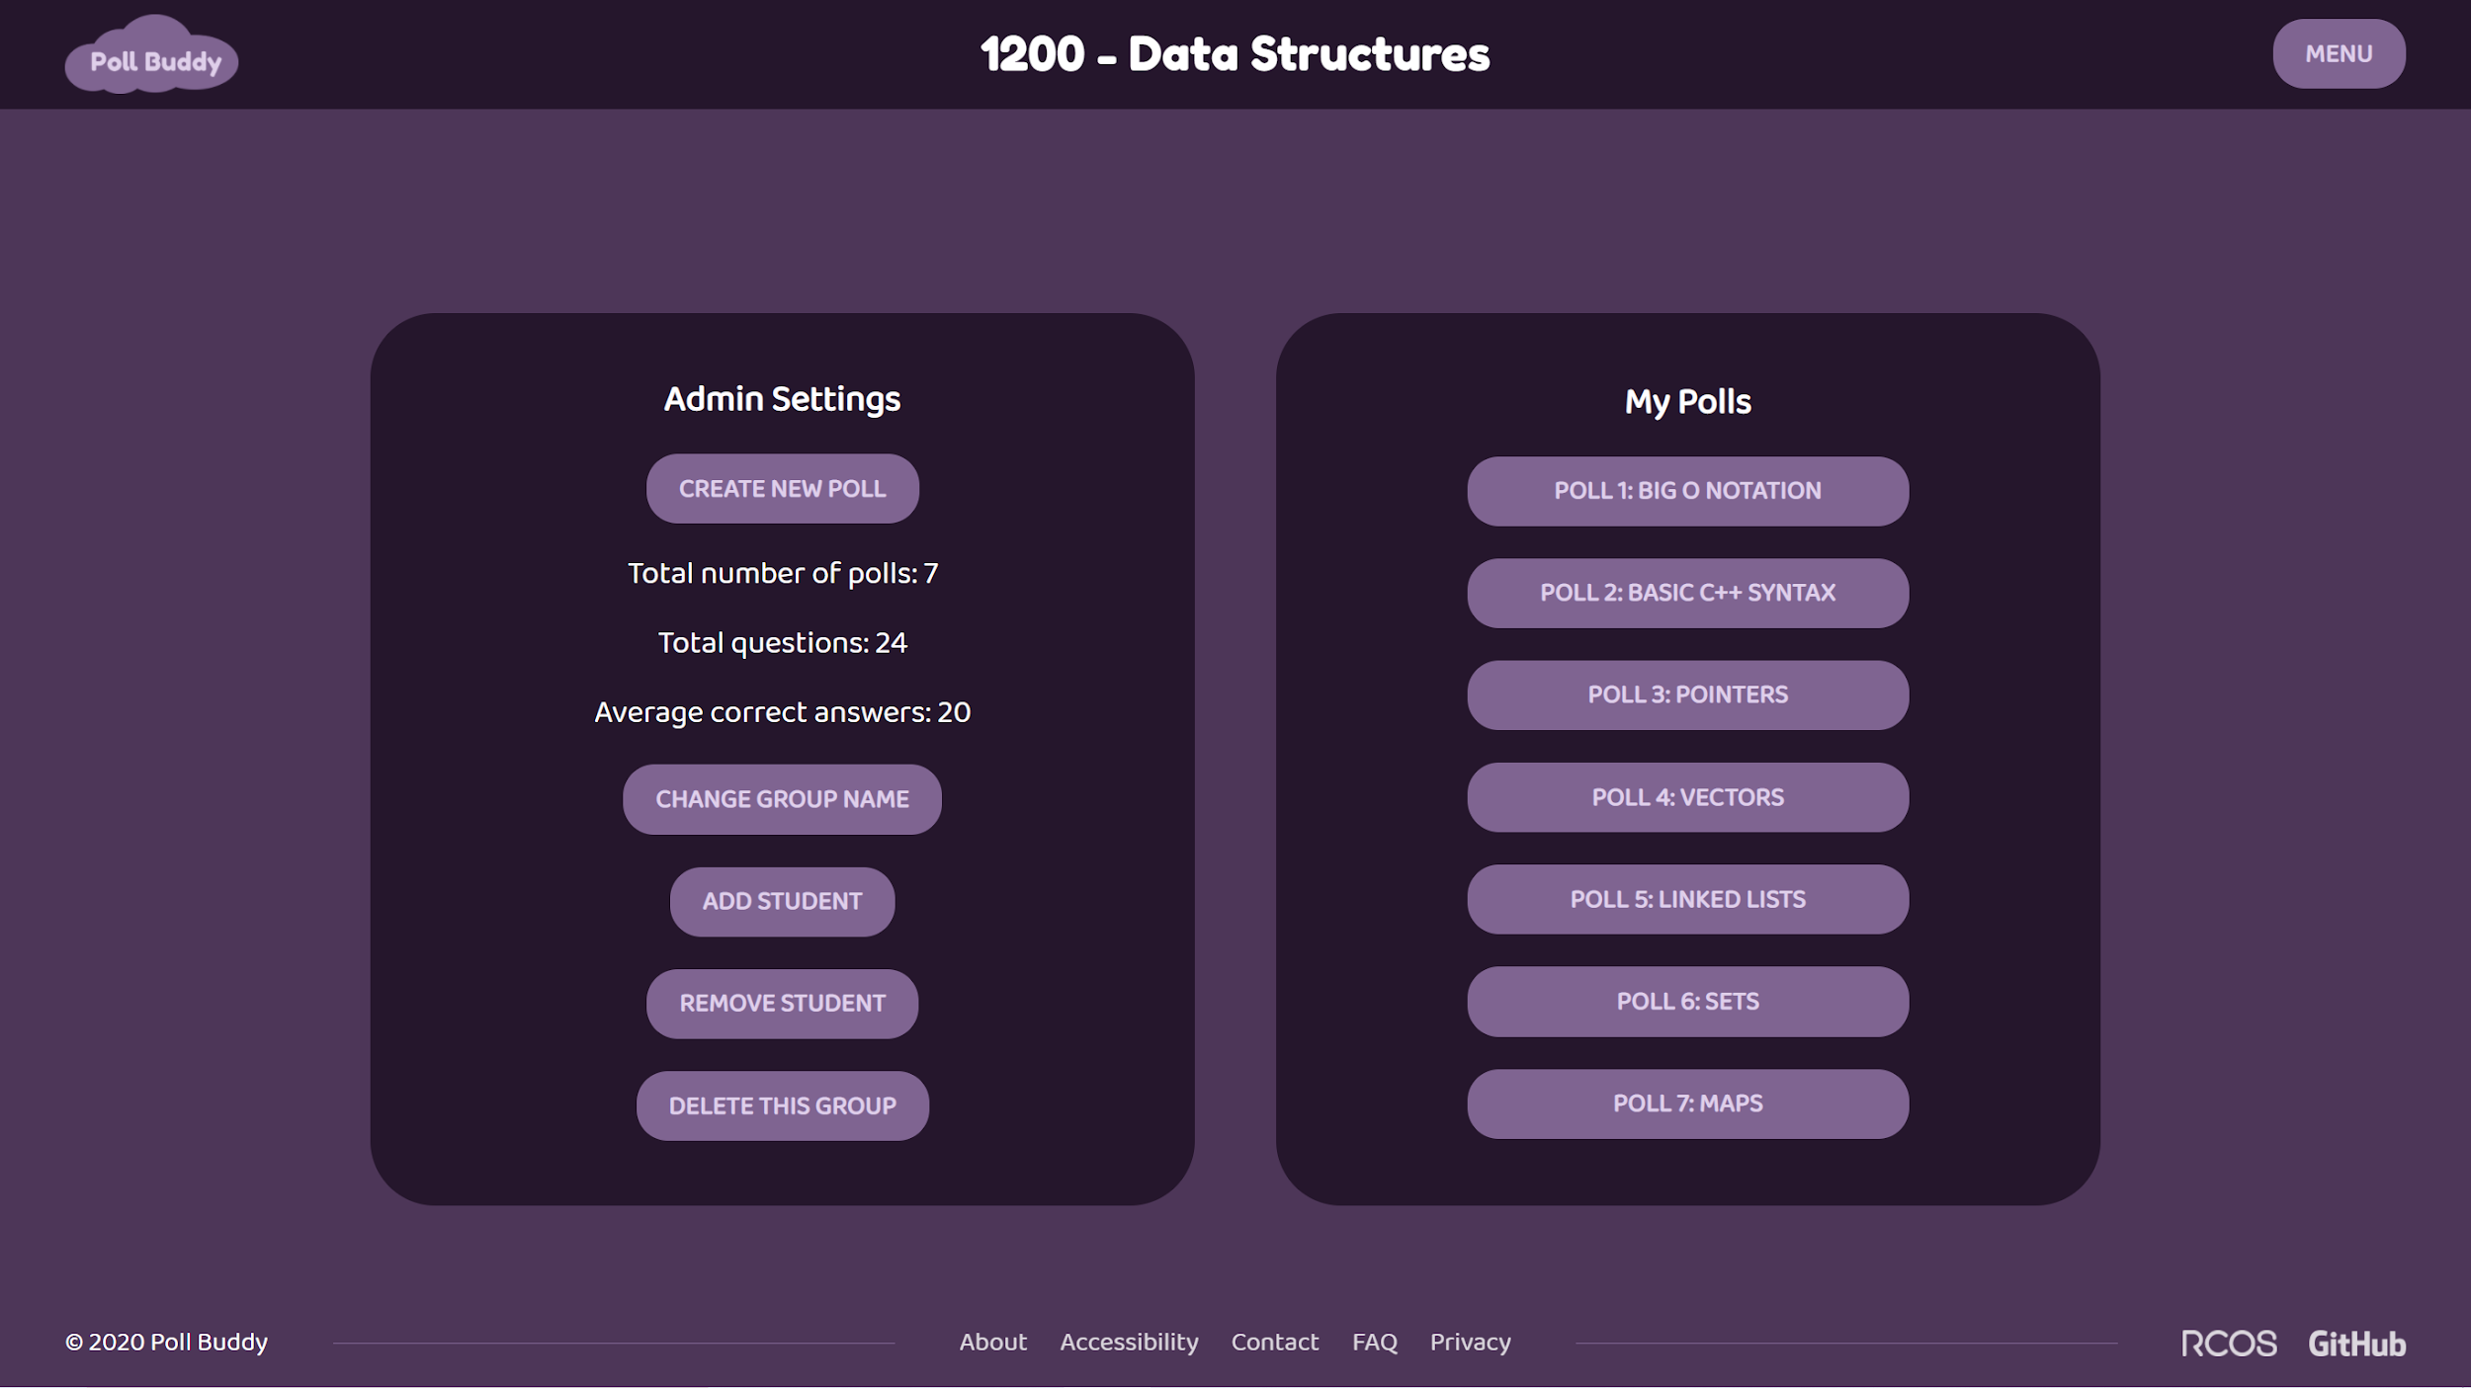
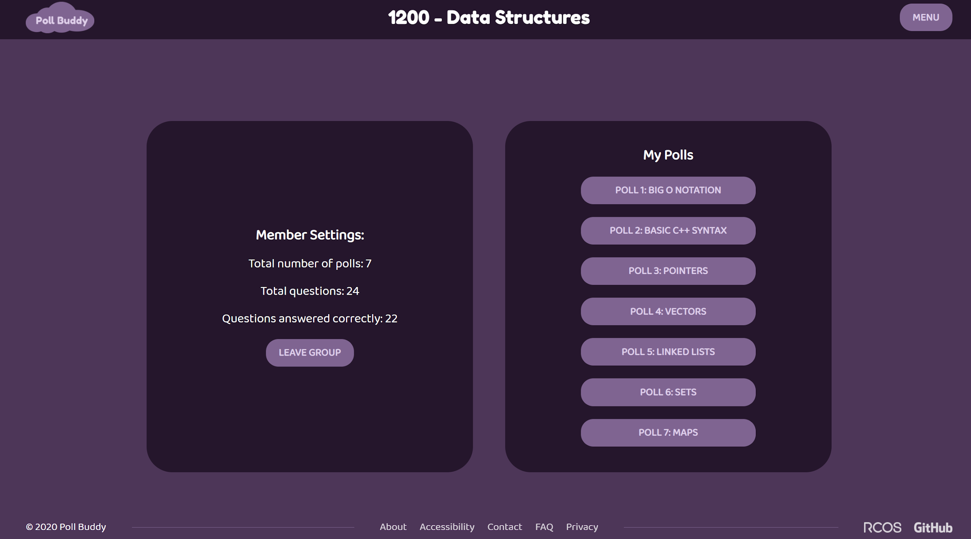
Settings/Polls
https://pollbuddy.app/groups/123/polls
Notes:
Presenter: Neha
Personally, this semester I worked on a bunch of different pages, but what I mainly ended up working on was the settings and polls page. As you can see, this page has settings on the left side and the list of polls on the right side. The left side changes depending on if the user is the admin or a member of the group and renders the correct settings component. All the information and buttons on the page render dynamically with a call to the backend, so it’s easy to change anything here with a simple backend call.

Slide 13
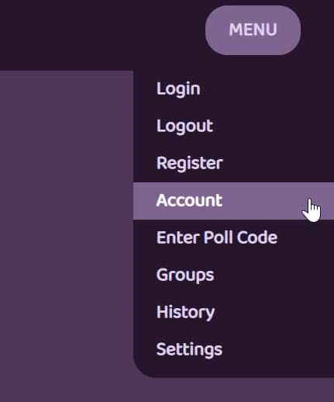
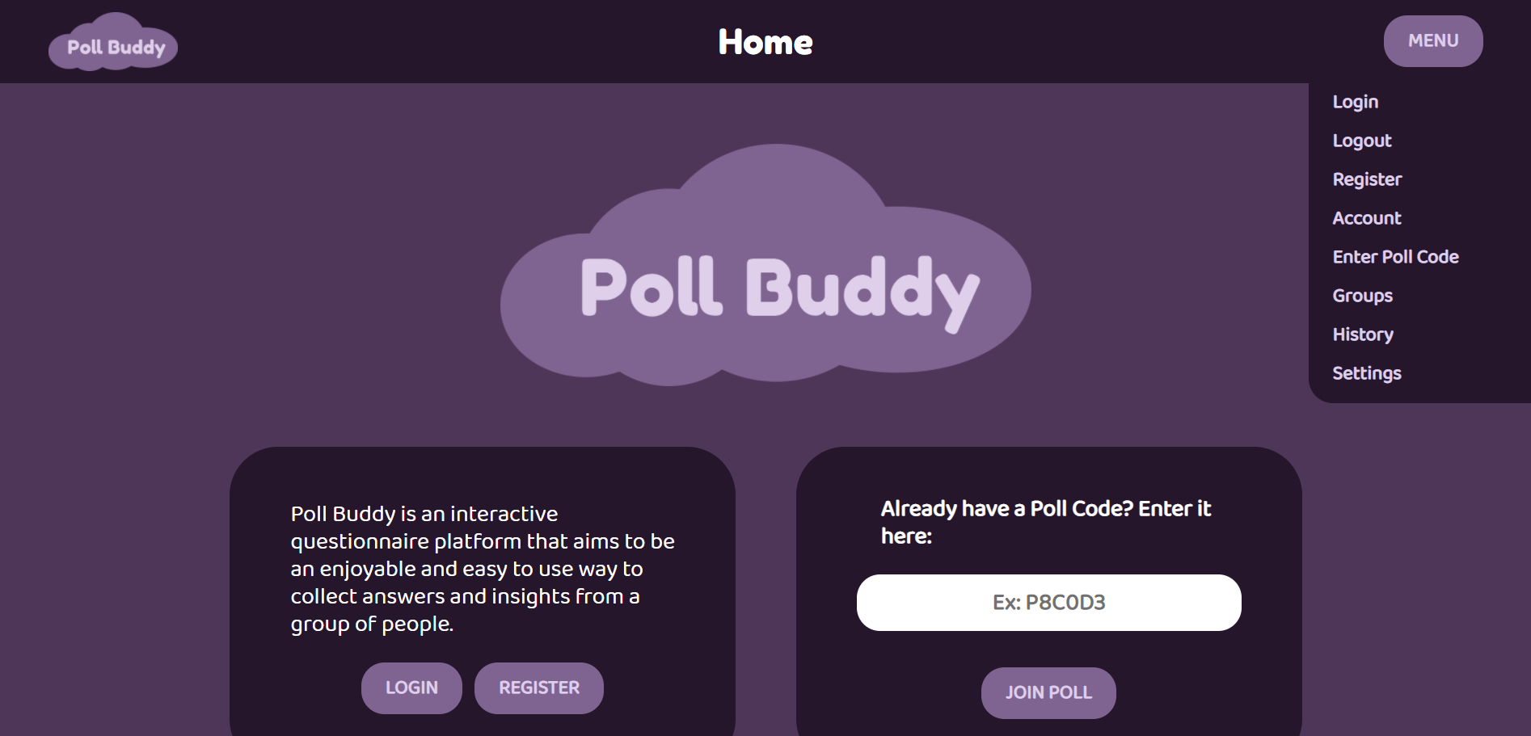
Dropdown Menu
Created React Dropdown component
Used state management to open/close
Allows for easy navigation of site
https://pollbuddy.app/
Notes:
Presenter: Jody
Hi I’m Jody, and this semester I spent a lot of time working on developing a dropdown menu for our home page. As this was my first time working with React as well as my first assigned issue, it was difficult for me to get started, but I am very satisfied with how the menu turned out. Users can open the dropdown by clicking the “Menu” button and can close it by clicking the button a second time or by clicking anywhere outside of the component. I used state management and event listeners to track whether the menu should be opened or closed at any given time. With the addition of this dropdown menu component, users are now able to more easily navigate Poll Buddy as all of the necessary pages are accessible from one central location.

Slide 14
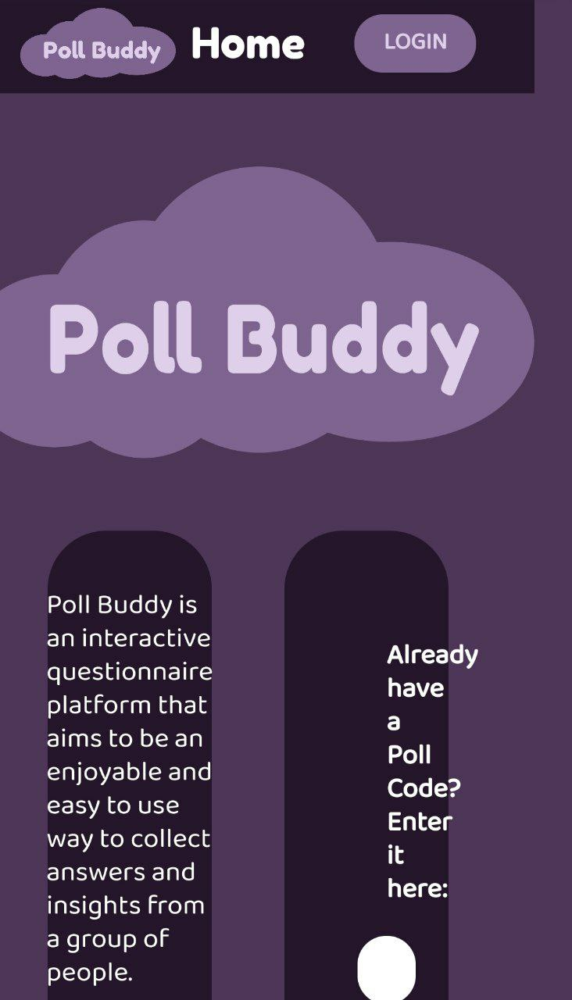
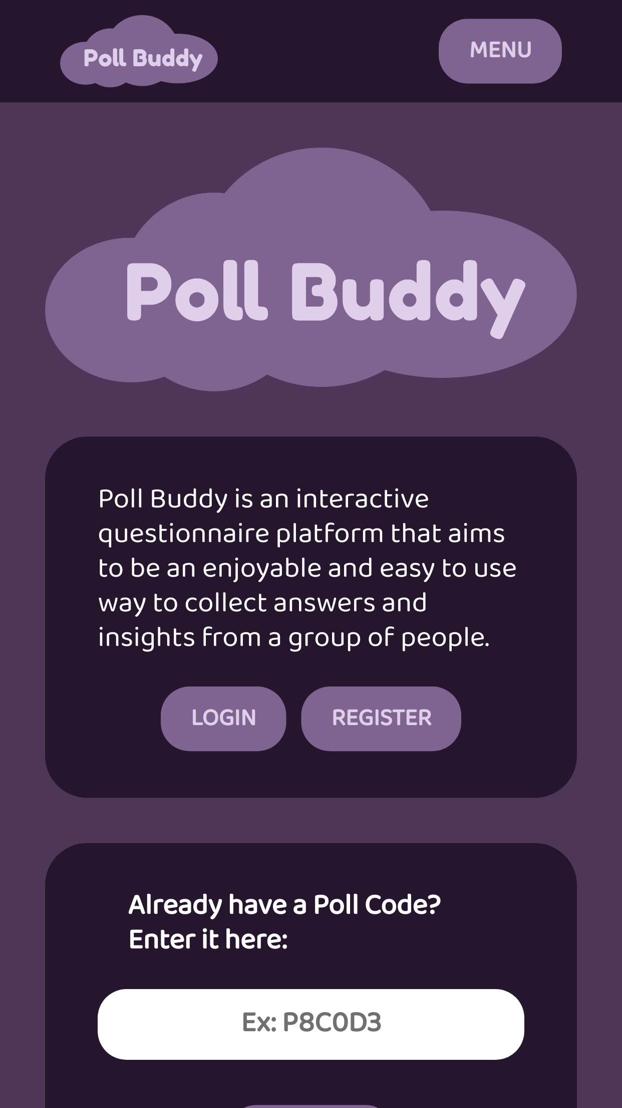
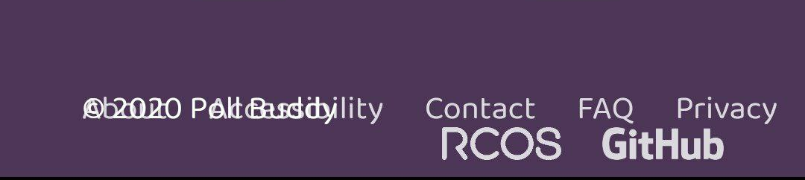
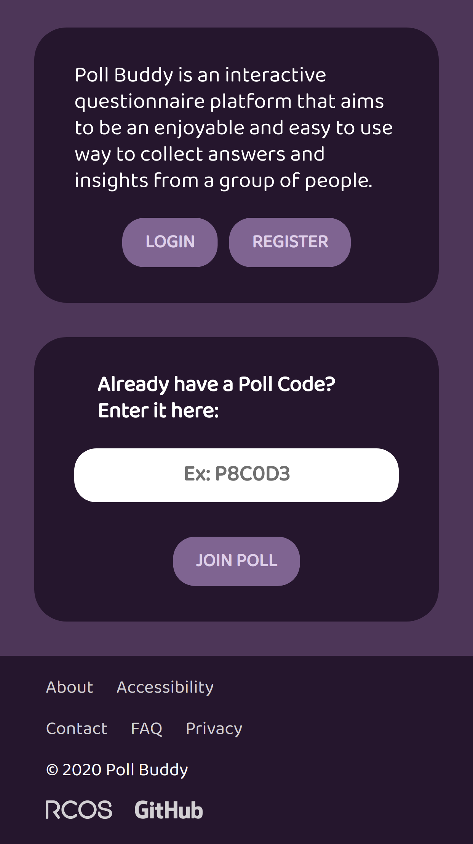
Poll Buddy is now mobile-friendly!
Restyled footer
Utilized aspects of mobile-first design
https://pollbuddy.app/
Notes:
Presenter: Annie
This semester I worked on adapting some of the old pages over to the current theme in addition to general css clean up. And more specifically, I worked on adapting Poll Buddy for mobile. You can see here in the slides, I’ve included before and after shots highlighted in red and green respectively. As you can probably tell from the before shots, we definitely did not take mobile into consideration before this semester; the footer was unresponsive and pages that use the two pane view like the homepage looked terrible on mobile. So, in an attempt to make the site usable on phones, I restyled the footer because our previous version was never intended for mobile. With the new footer, the links wrap and you can now click on them! With two columned pages, I changed them to display as single columns for devices under a certain size. Most of the other changes for mobile were also just resizing for different resolutions. In adapting to smaller screen sizes, I also modified the affected css files to take a mobile-first approach, so that the base css is styled for the smallest of screens and it should adapt as the screen size increases and hits larger breakpoints.

Slide 15
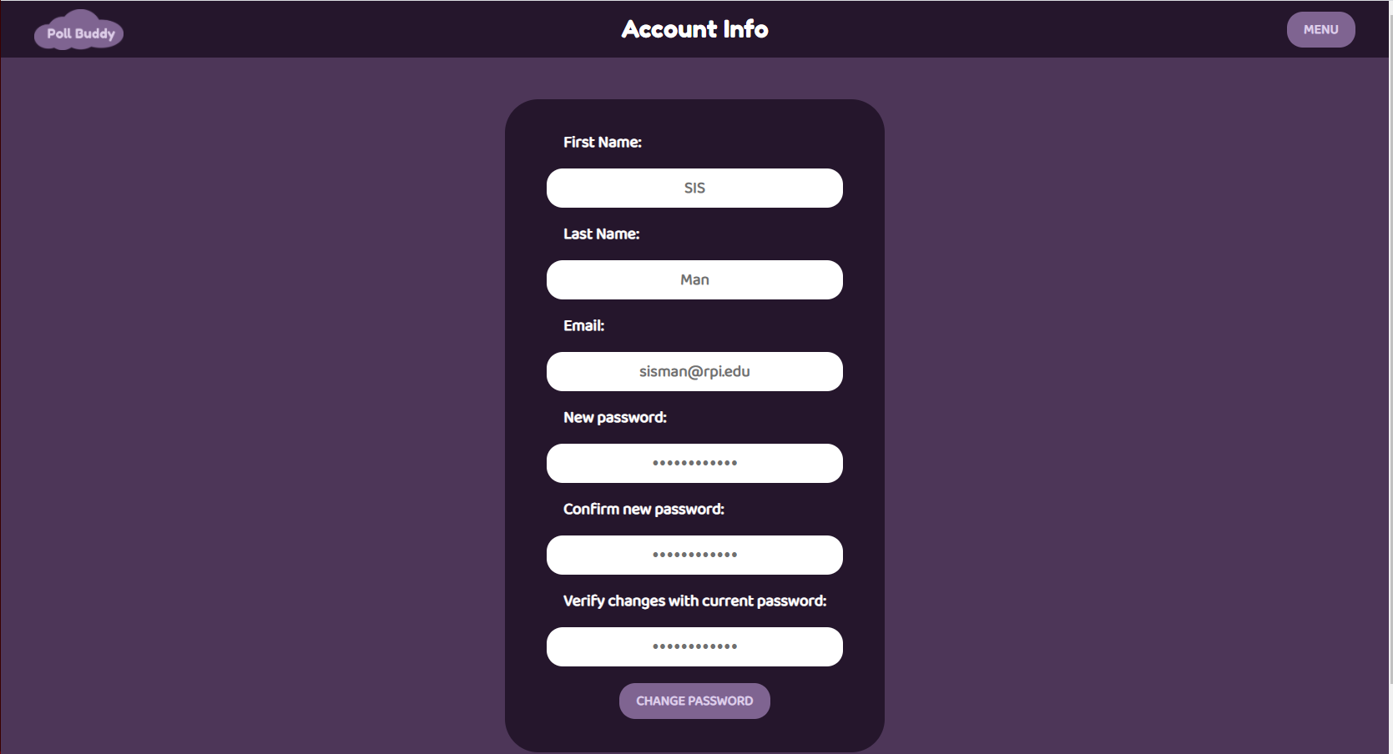
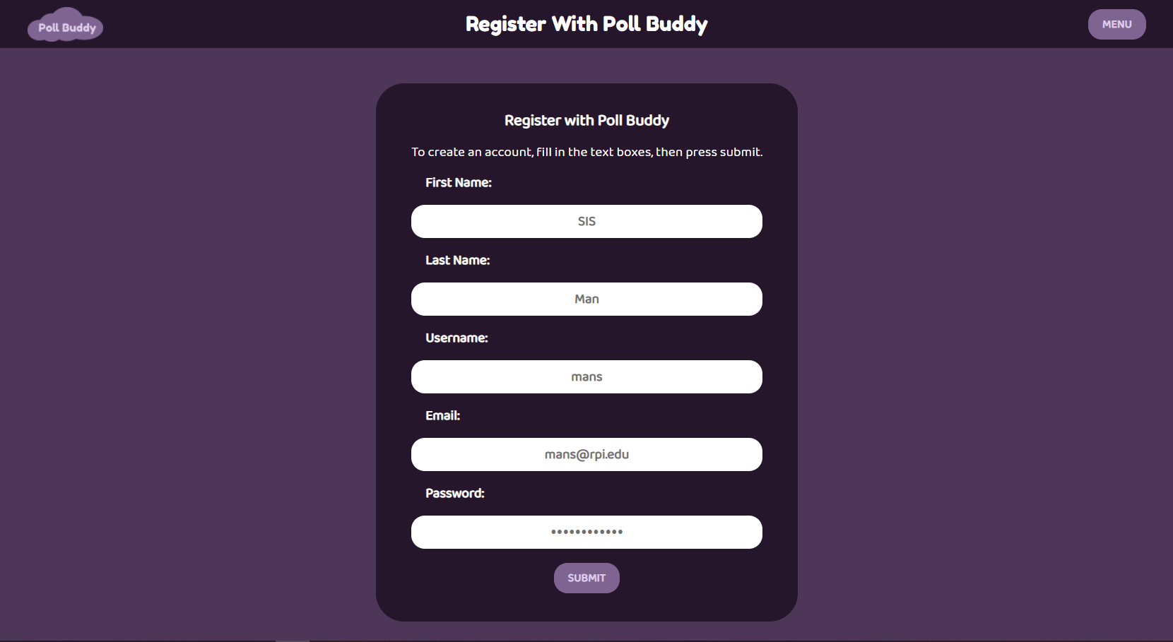
Account/Registration Details
https://pollbuddy.app/account
https://pollbuddy.app/register/pollbuddy
Notes:
Presenter: Maria
I separated the name option in the account and registration pages to be first name, last name, email, and password as well as adding a readonly username option in the registration page. This was my first time working with React.js and web development but it was nice to successfully submit a few pull requests for an issue.

Slide 16
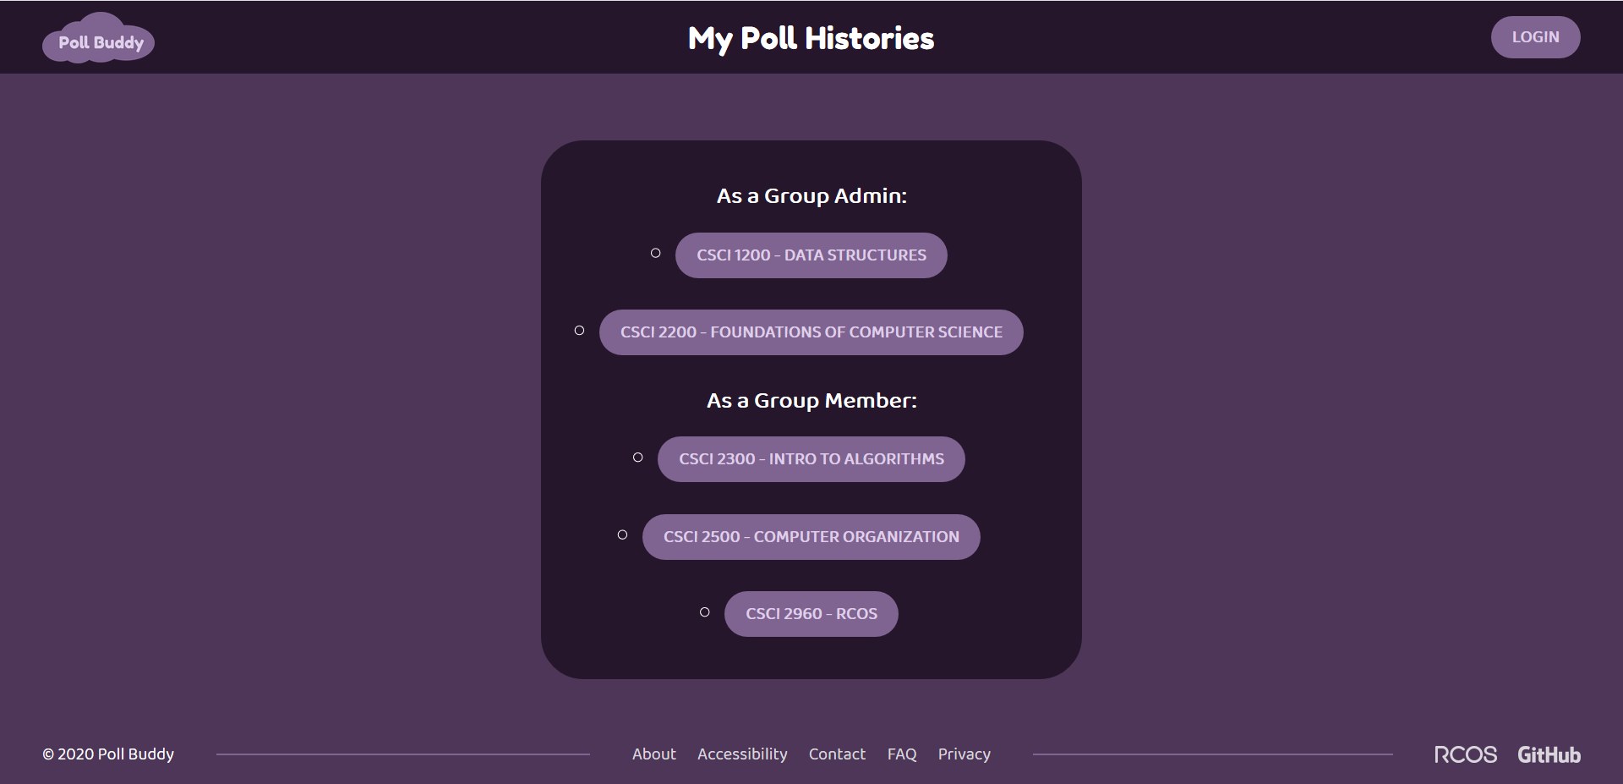
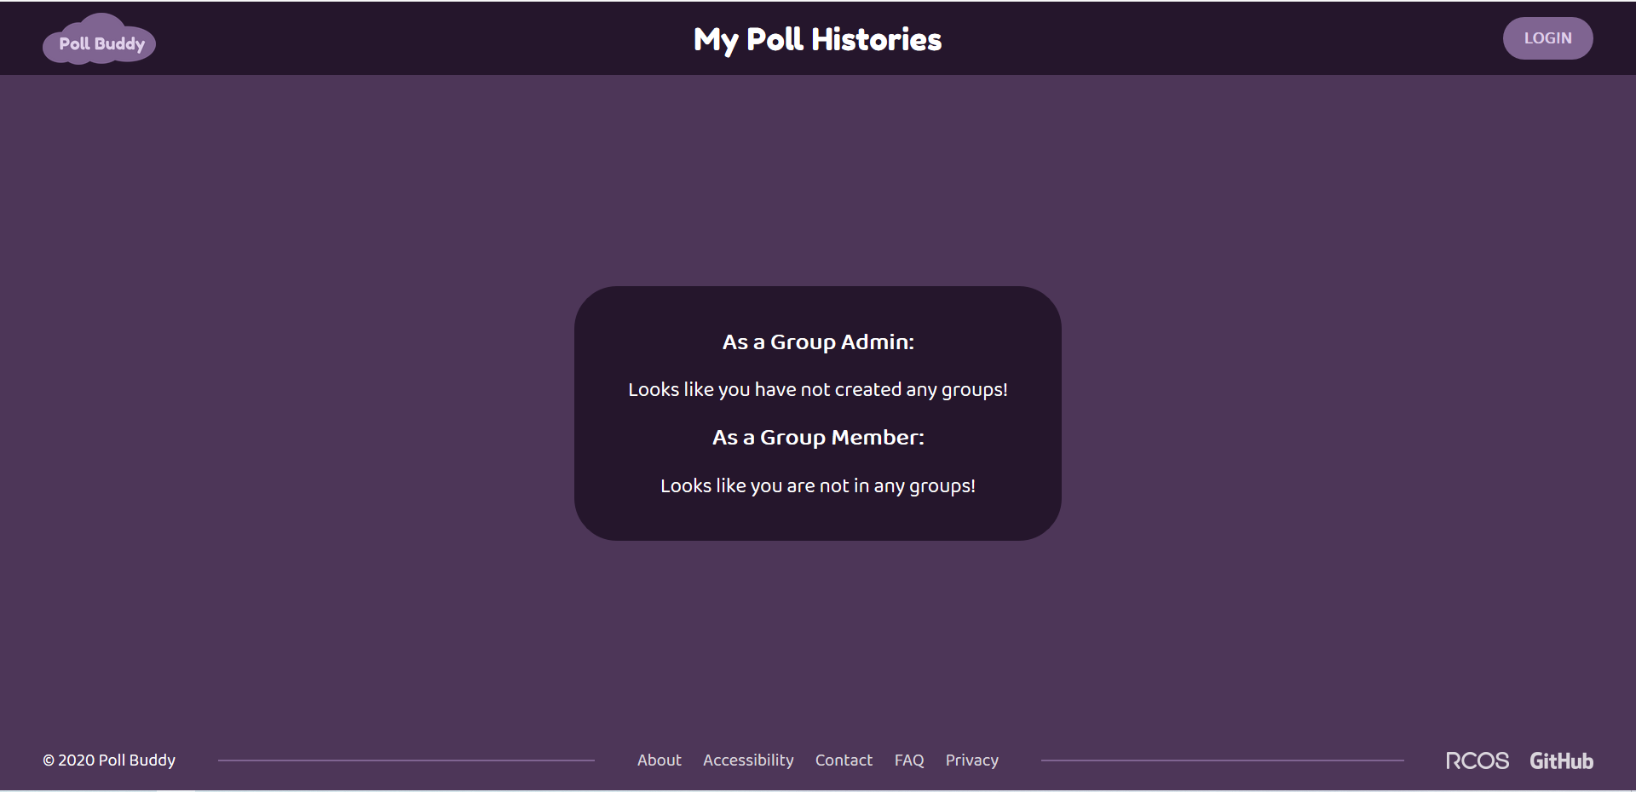
Poll History
https://pollbuddy.app/polls/history
Notes:
Presenter: Yao Dong
I worked on the page pollHistory where a user (either admin or group member) can view the list of all the groups and access their poll history with said group using the button for each group.

Slide 17
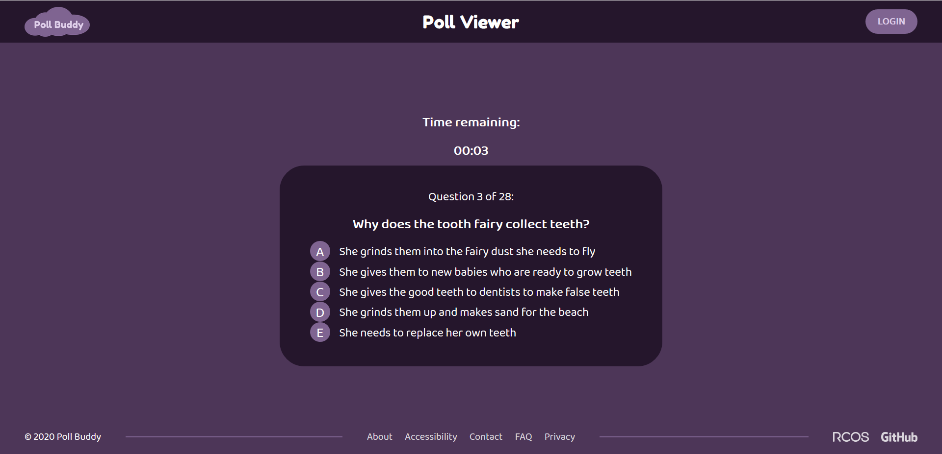
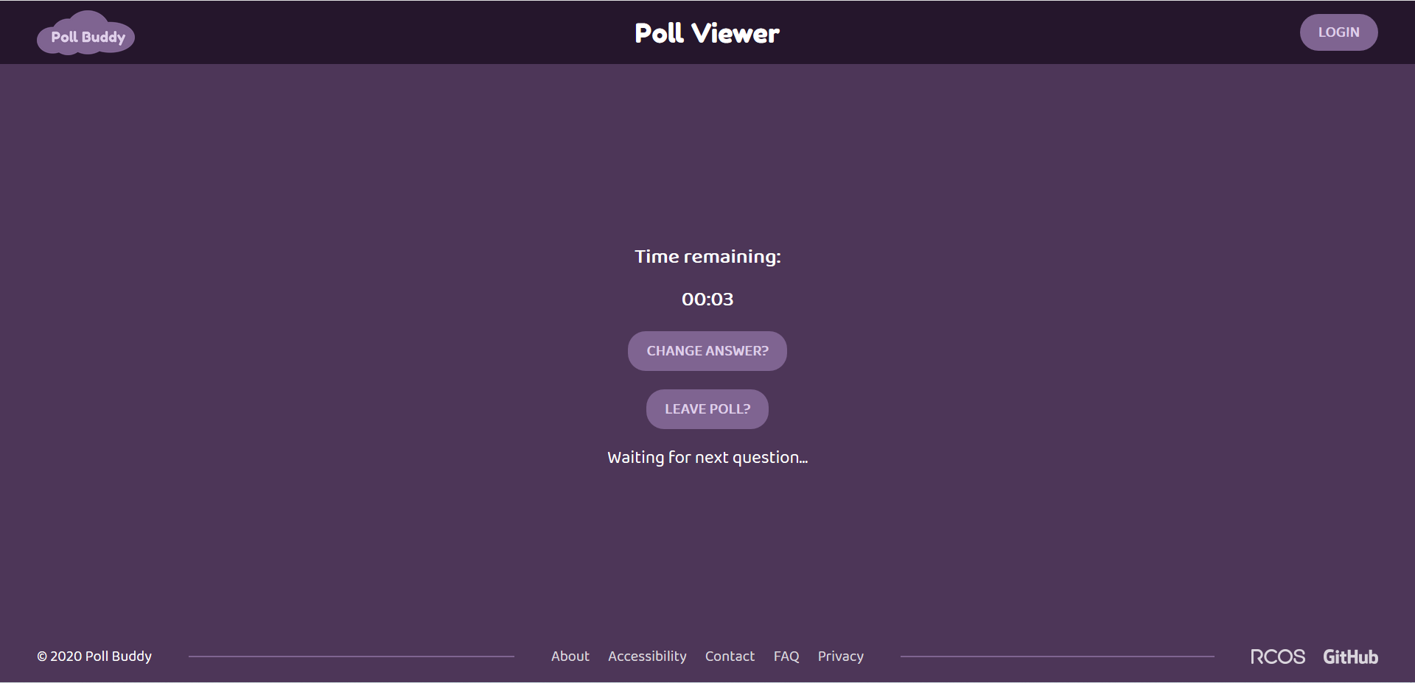
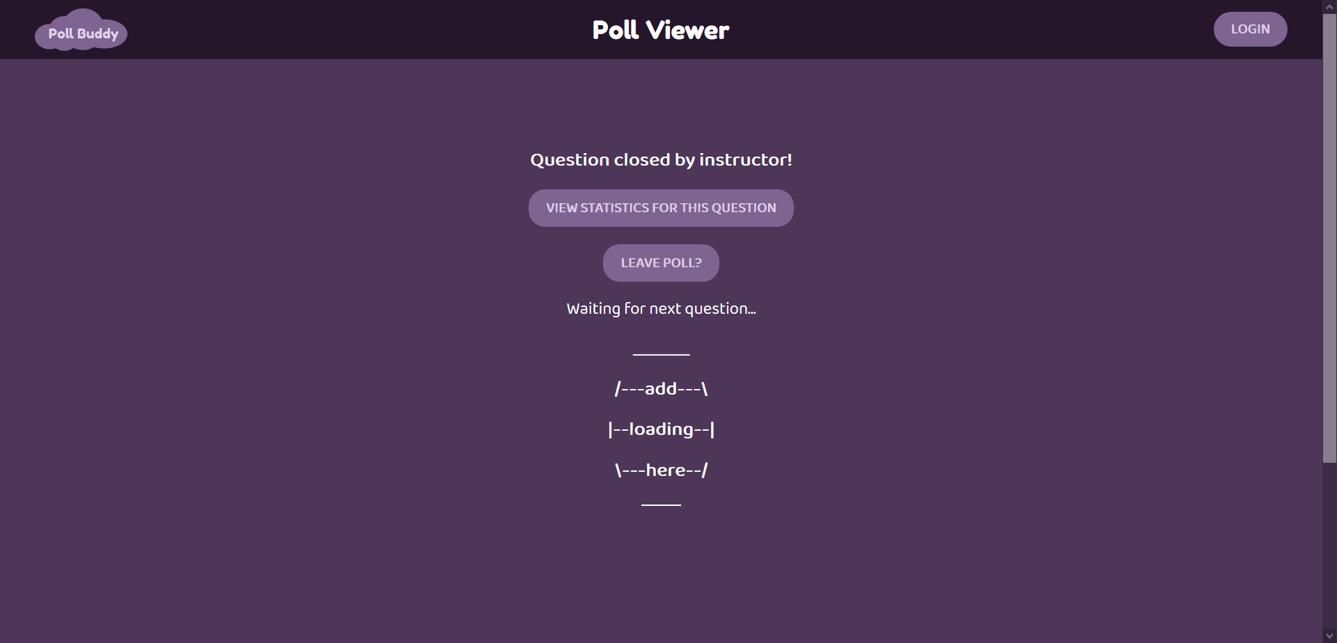
Poll Viewer Merge
https://pollbuddy.app/polls/5fc86a9974b9fa7c7b88d2ee/view
Notes:
Presenter: Yao Dong
I worked on issue to merge three pages: PollViewer, AnswerRecorded, and QuestionEnded, so instead of having 3 pages, we have one page - PollViewer, where the contents of the page is changed through the use of a timer and a state. So initially PollViewer state shows up with the timer, allowing the user choose an answer. This will put the user to the AnswerRecorded with a timer, which contains a button that allows the user to return back to PollViewer state to change their answer. Both state will be redirected to the QuestionEnded state when timer hits zero.

Slide 18
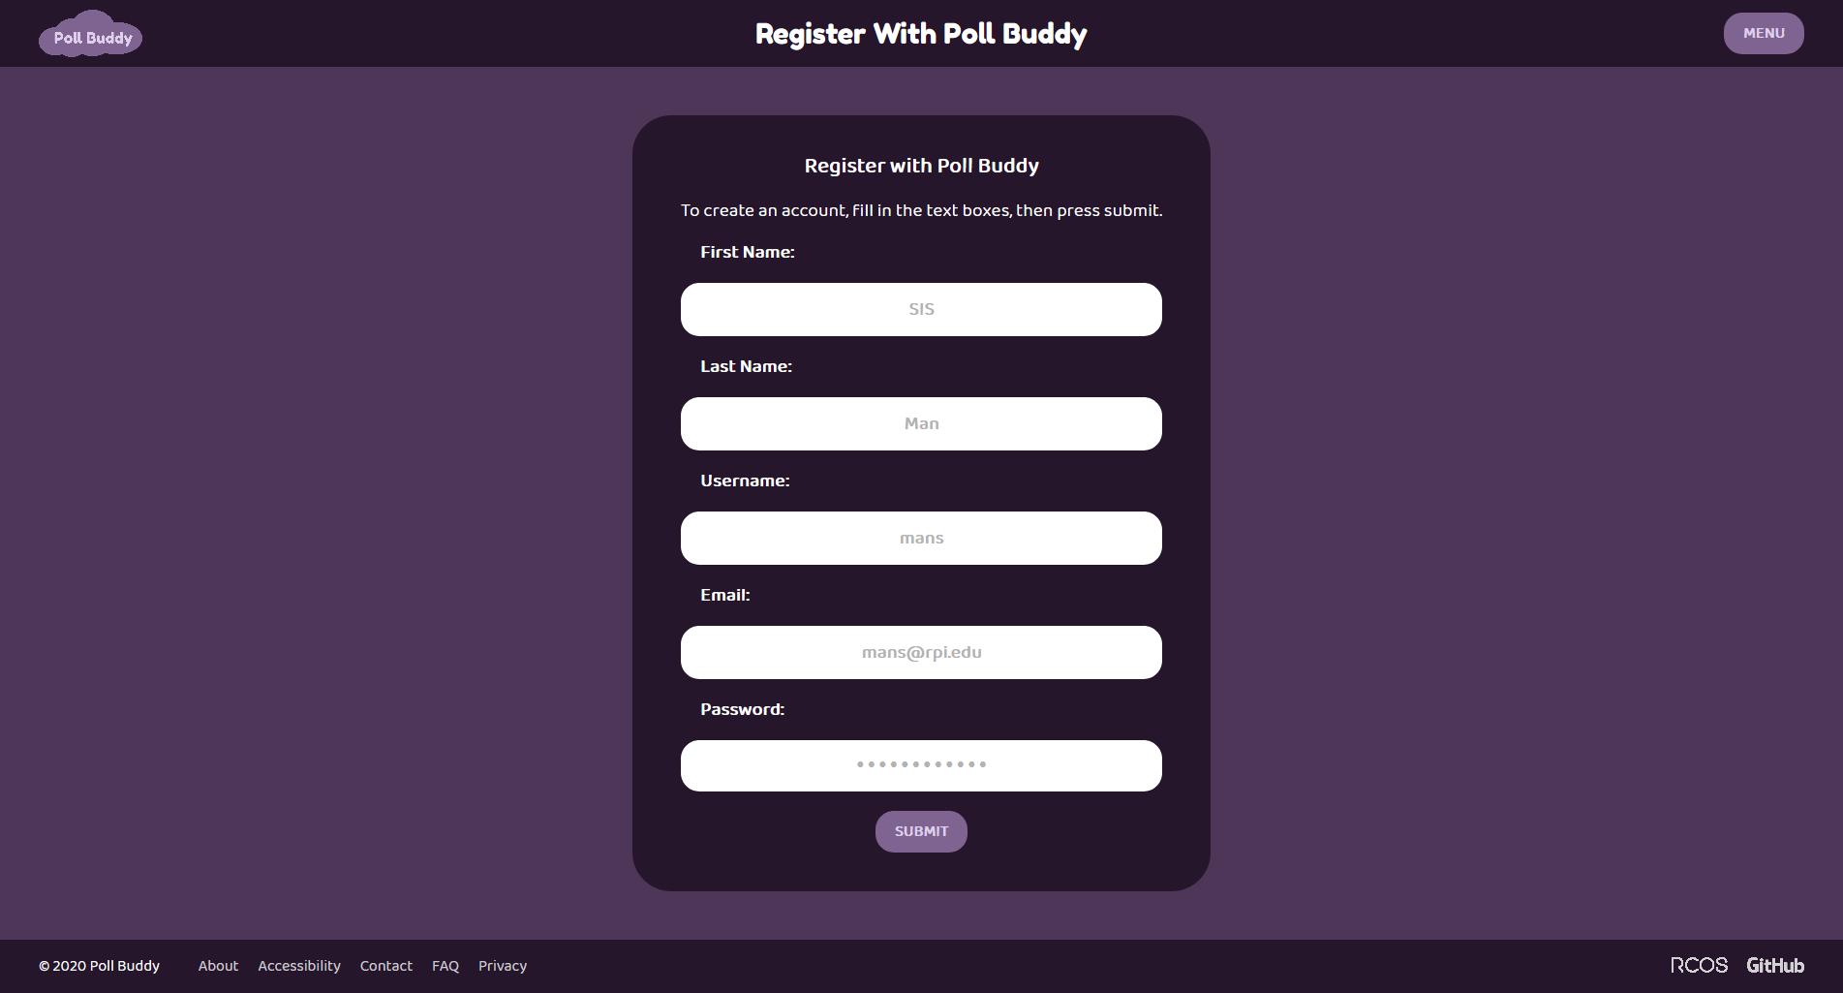
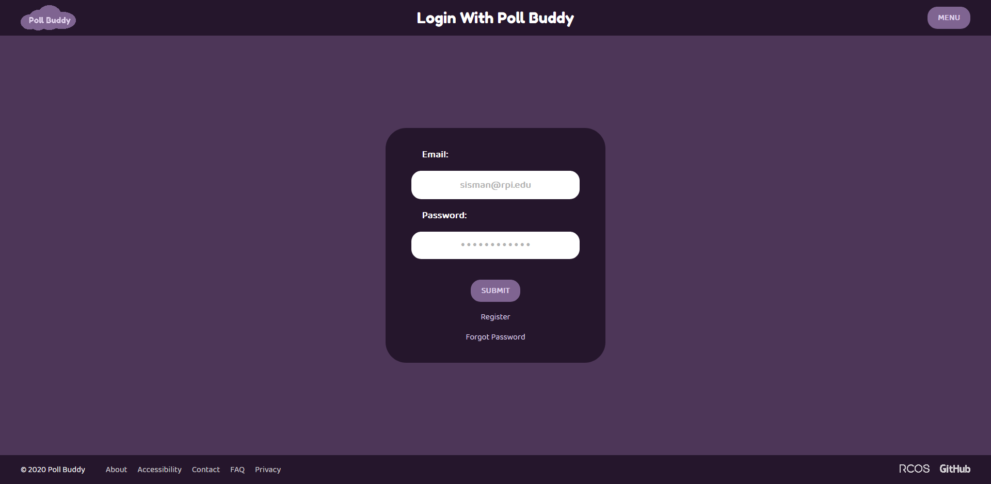
Login/Registration
Integrated backend with frontend login and registration pages.
Added validation for registration.
https://pollbuddy.app/login
Notes:
Presenter: Aidan Lane
Added functionality to allow users to register with poll buddy (also does regex validation). Users can then login with these registered accounts.

Slide 19
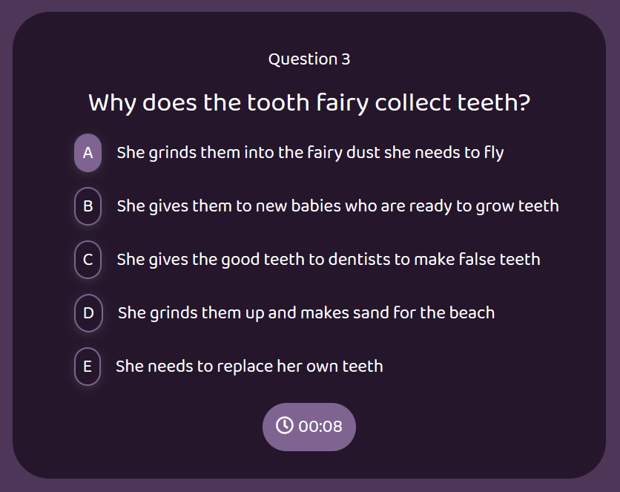
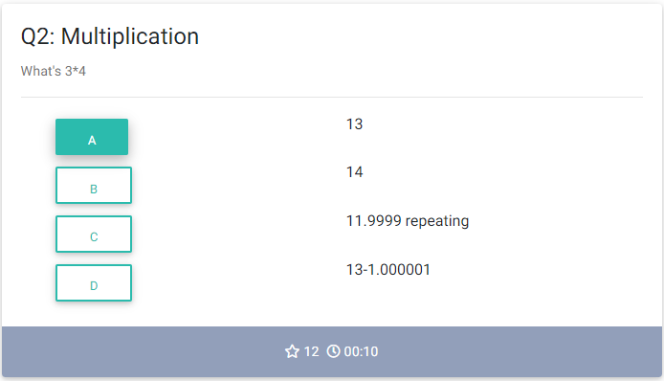
Question Component Update
Notes:
Presenter: Nicholas
The question component was very outdated so I updated it to be consistent with PollBuddy’s new design.
Takes JSON in props
Made the answer labels auto generate
Fixed the timer functionality
Made it so that selecting more choices than the maximum allowed choices unselects the first choice you picked

Slide 20
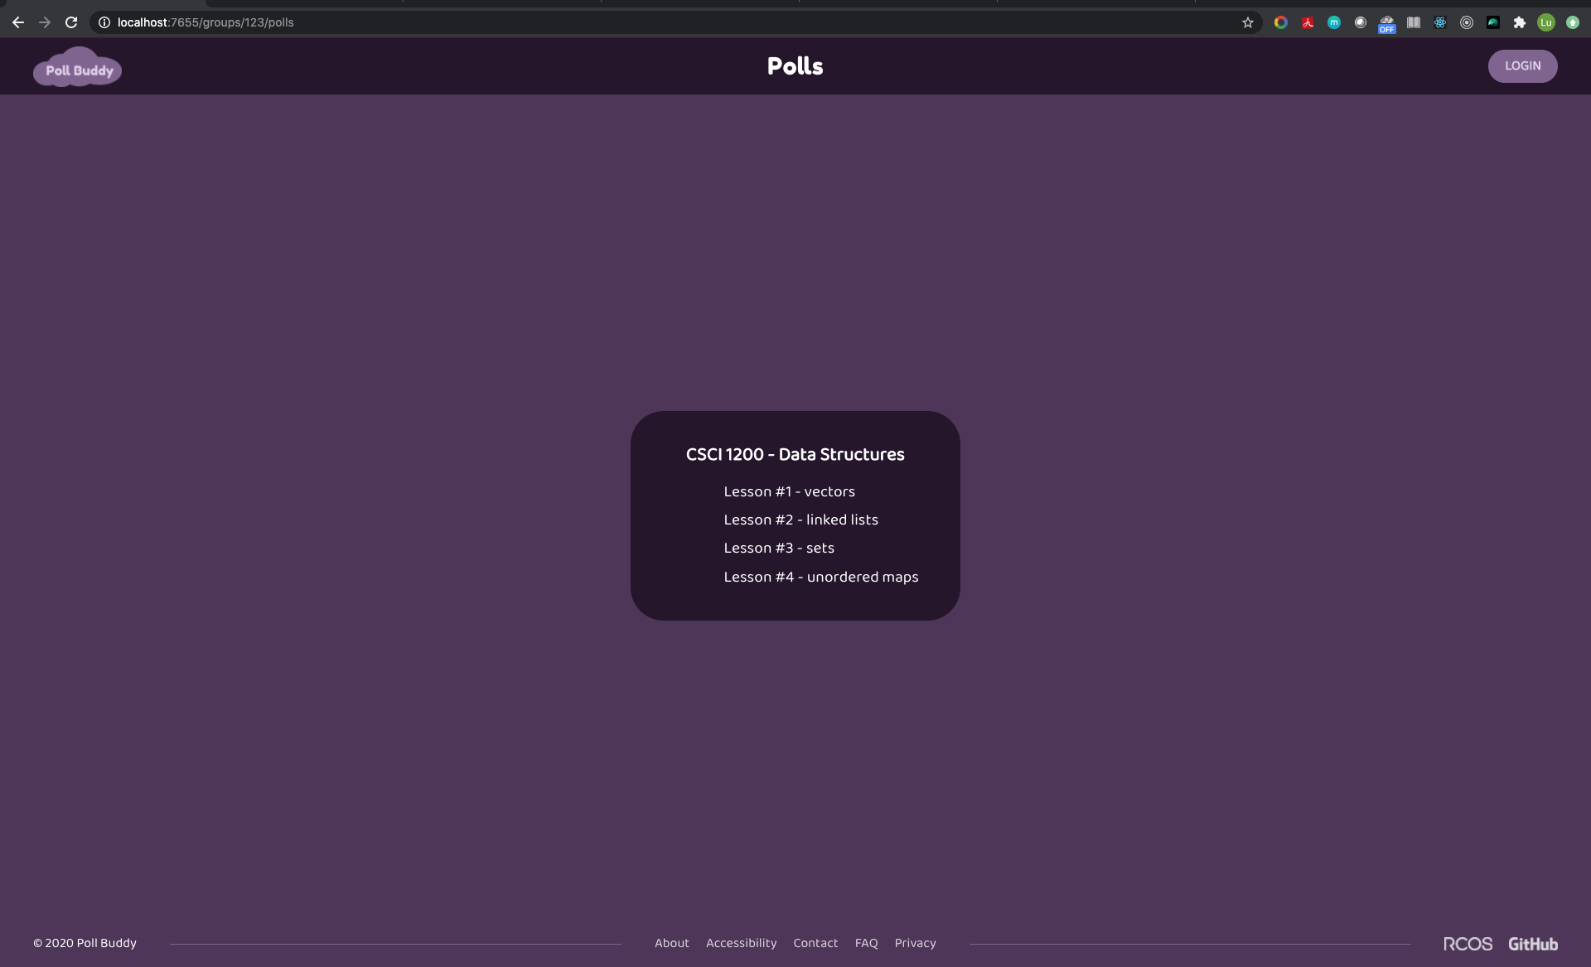
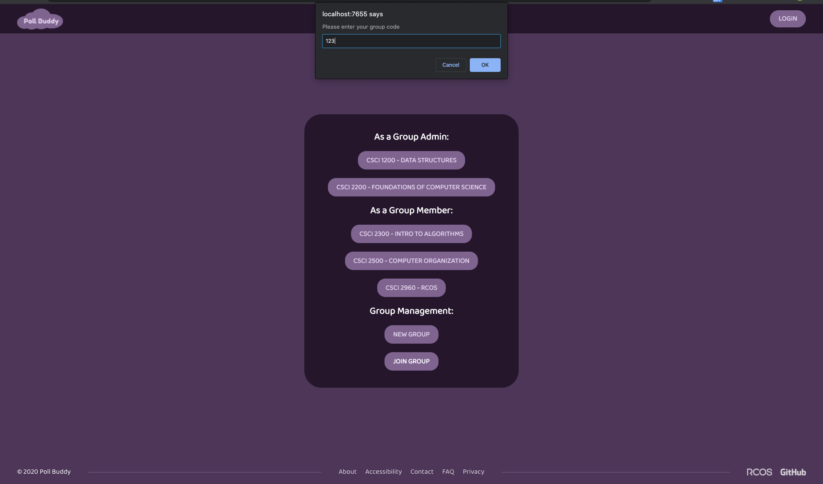
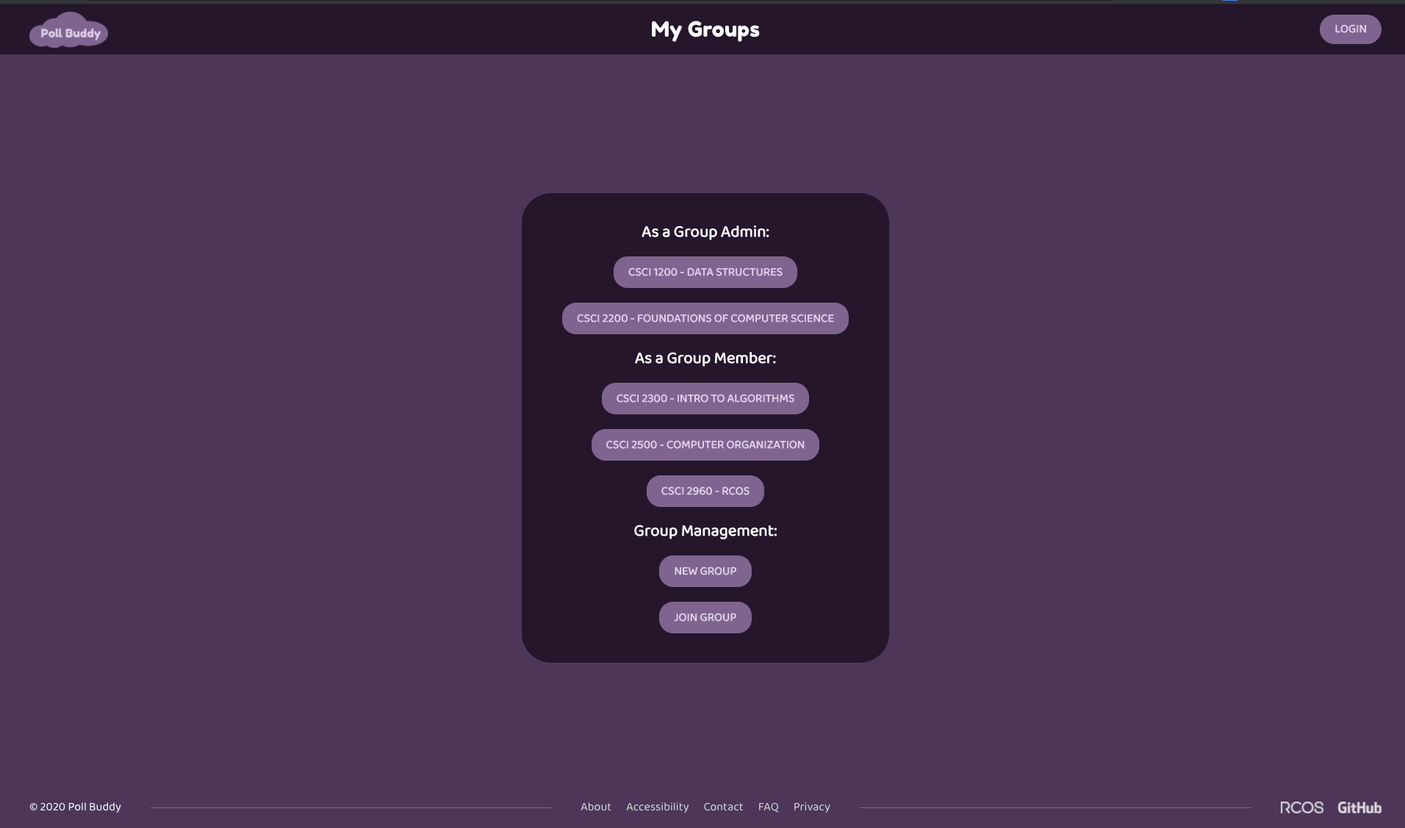
Join Group
Enzhe Lu

Slide 21
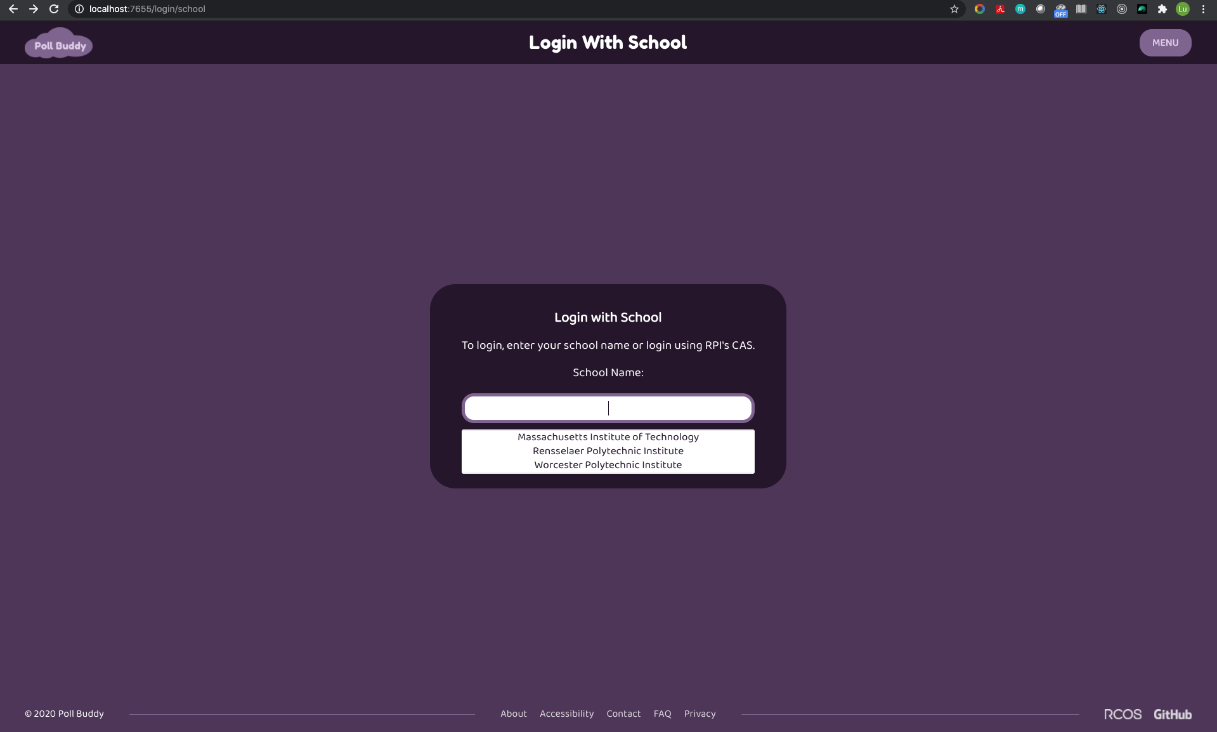
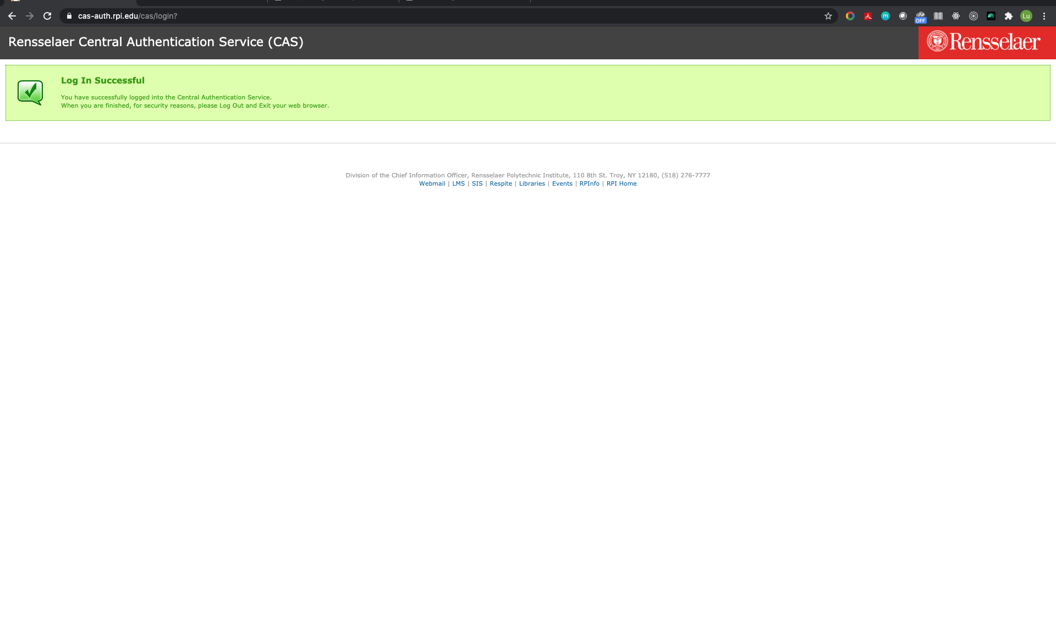
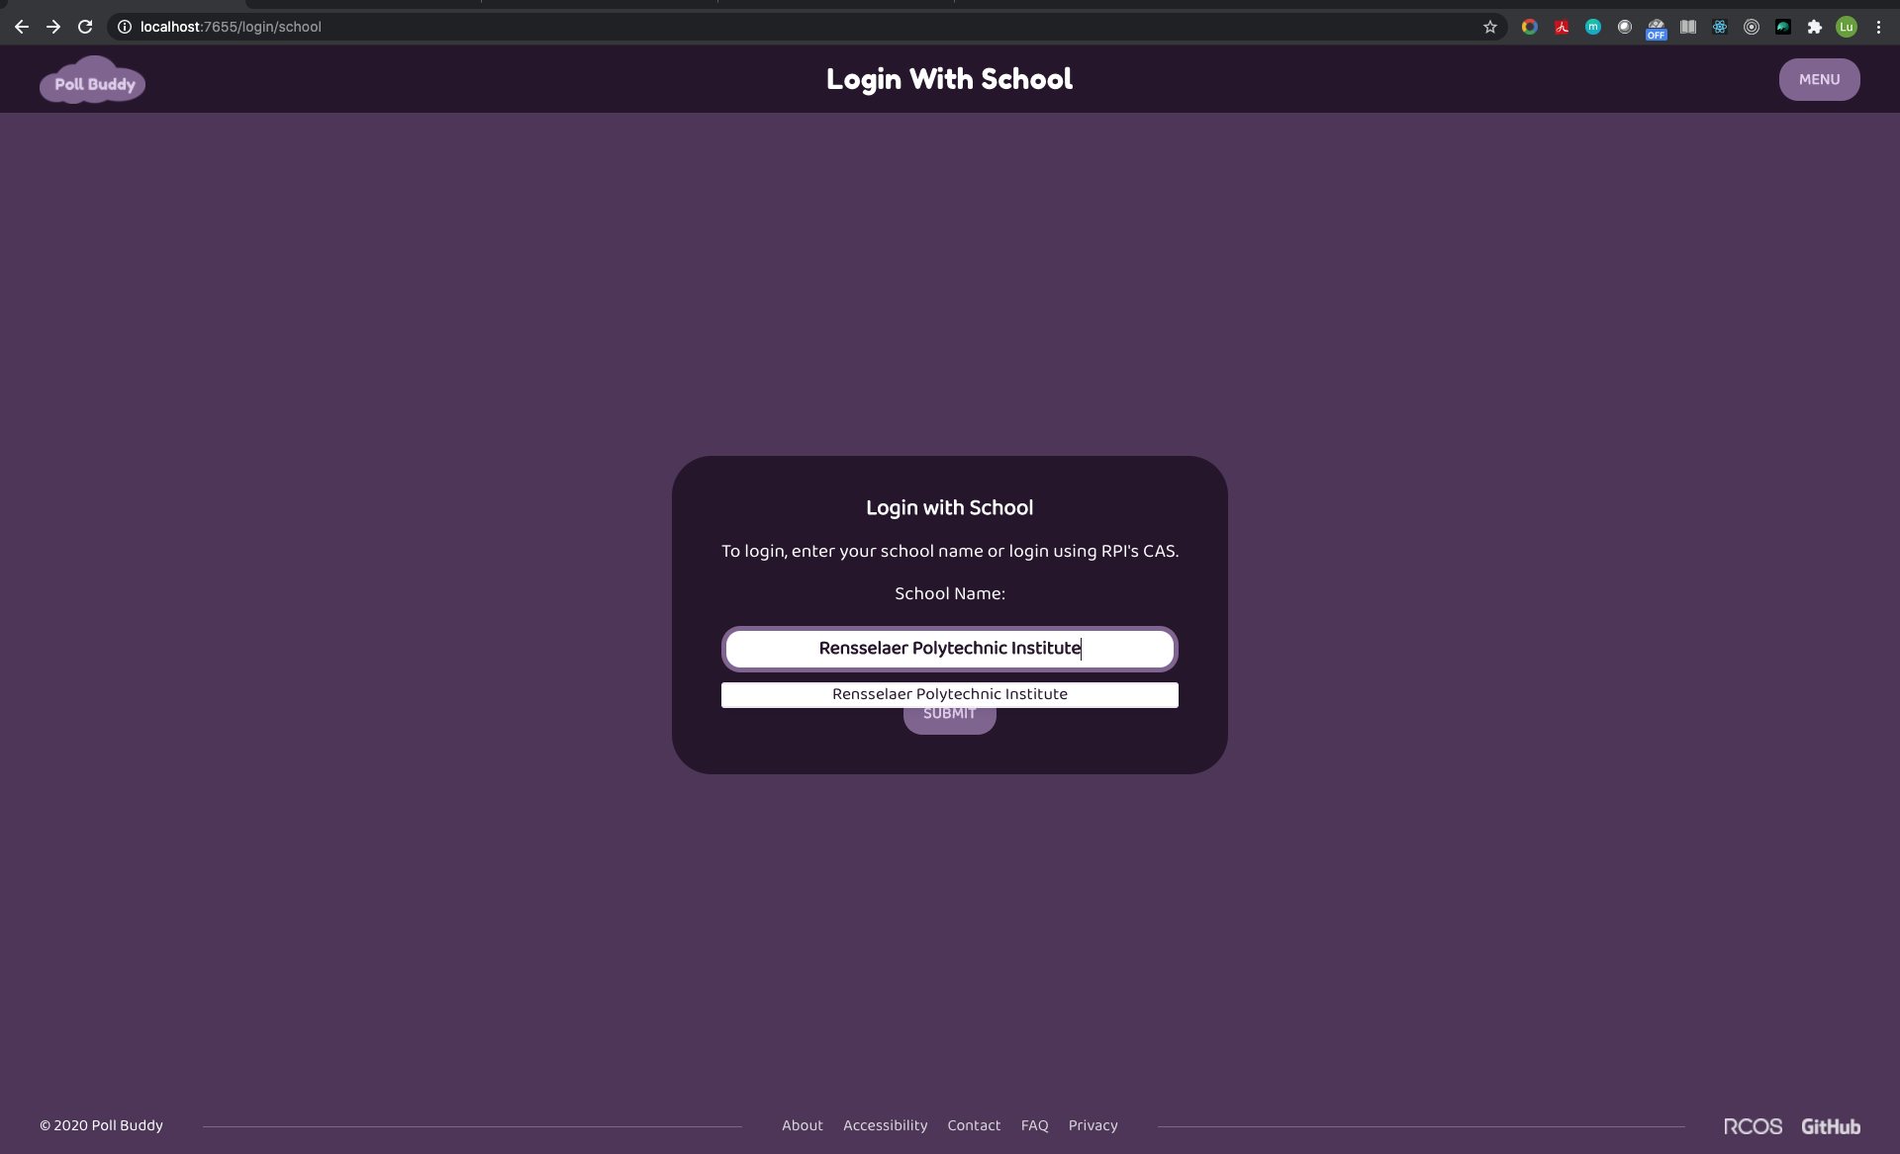
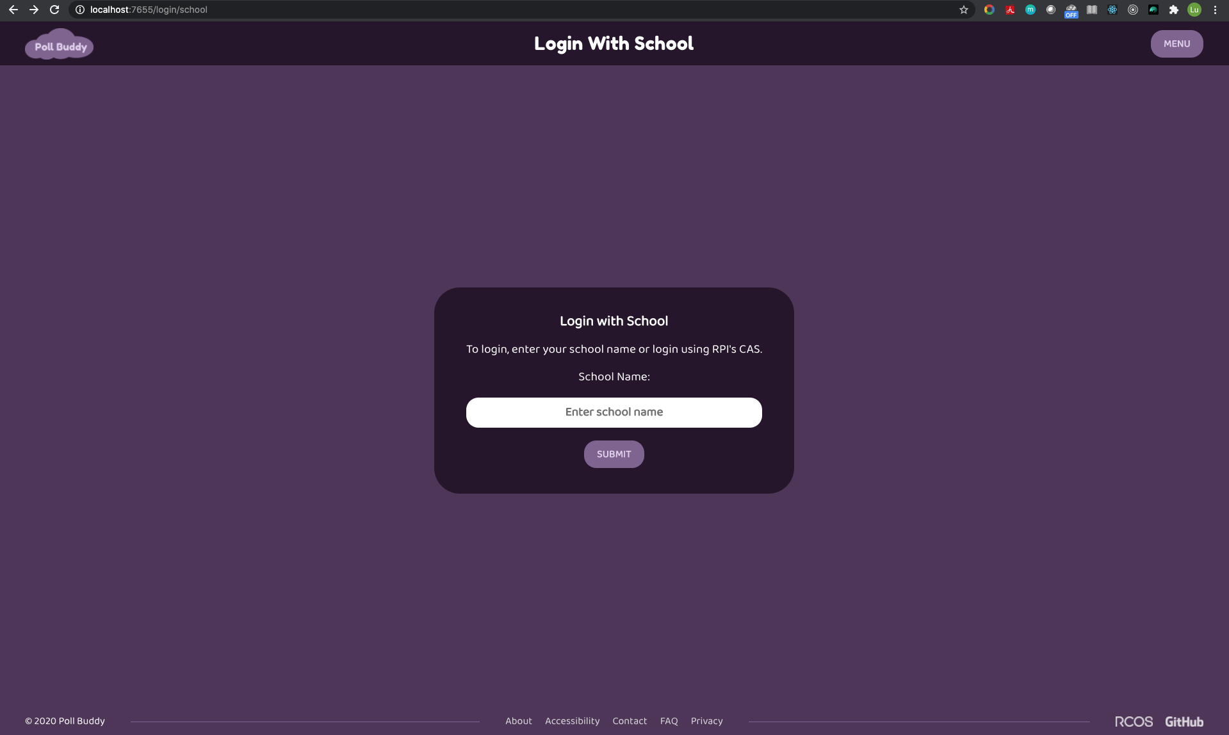
Login/Register With School
Enzhe Lu

Slide 22
Login/Register With School
Enzhe Lu
Frontend
Components
SchoolPicker
Pages
LoginWithSchool
RegisterWithSchool

Slide 23
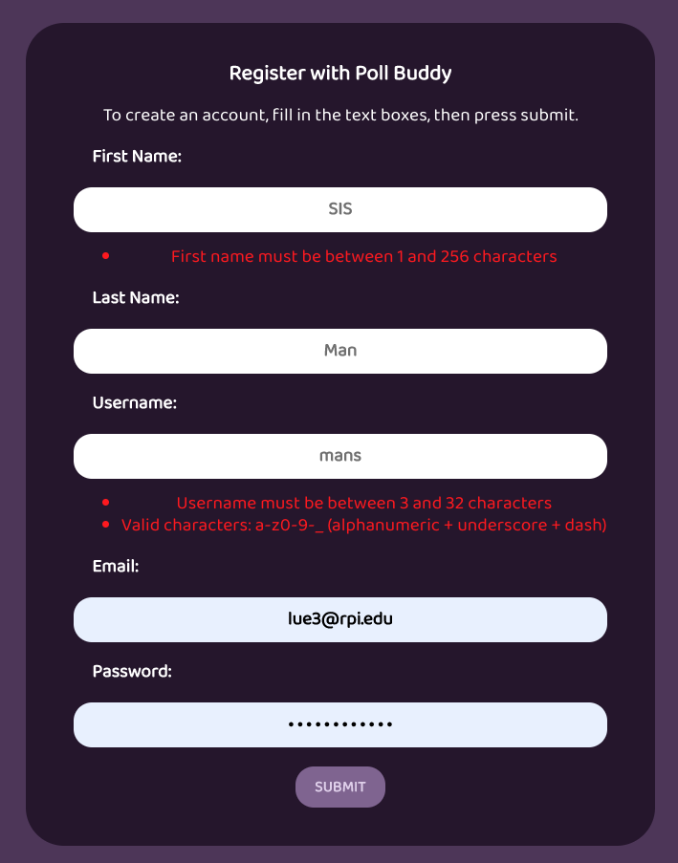
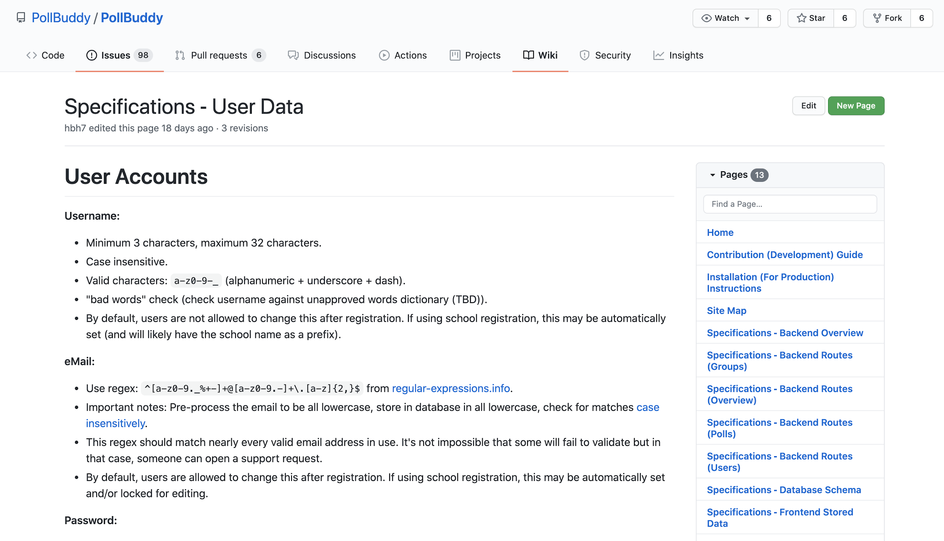
Registration validation
Enzhe Lu

Slide 24
Back End
Notes:
Presenter: Hunter
Hi again, I’m back to talk about the backend now.

Slide 25




Backend Technologies
Docker
NodeJS
Express
MongoDB
Notes:
Presenter: Hunter
As a brief overview, the backend technologies we are using are Docker, NodeJS, Express, and MongoDB. Docker makes packing up the app simple and easy, NodeJS powers the JavaScript code we use, Express makes setting up an API easy, and MongoDB stores all our long term data.

Slide 26
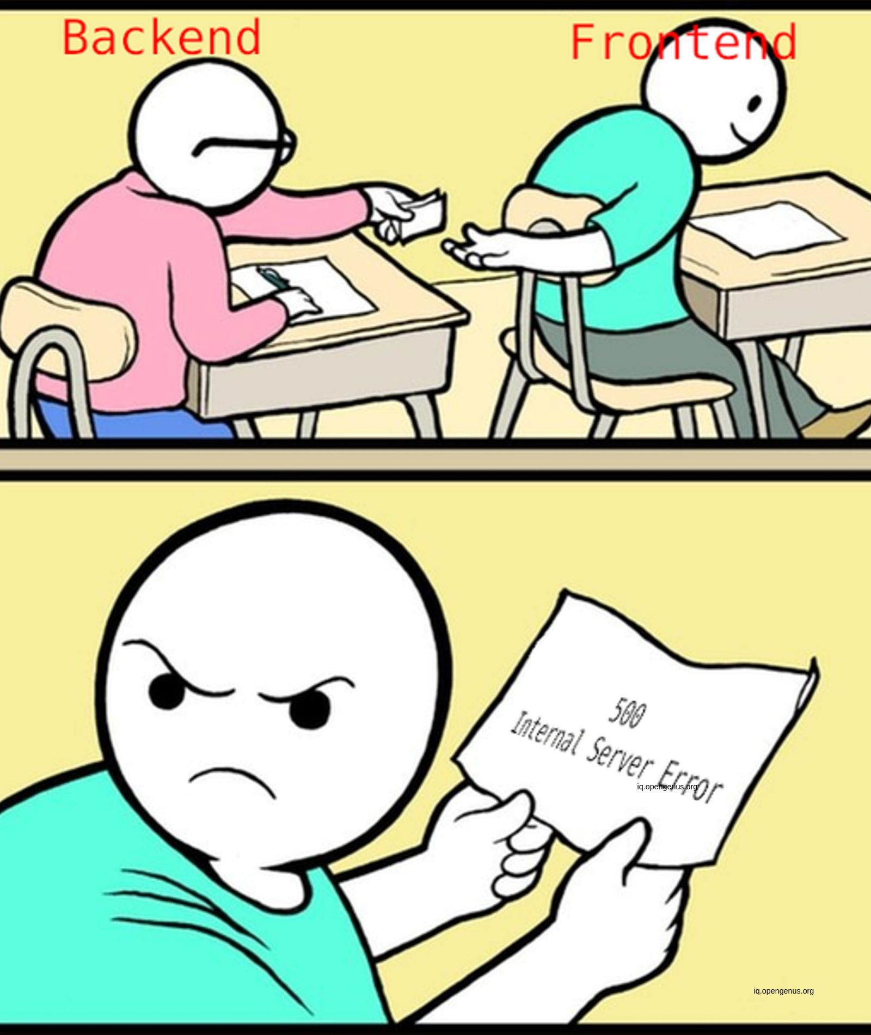
Backend Tasks
Further integration with frontend
API documentation
Additional endpoints for frontend features
Login functionality
CI/CD renovations
Docker renovations
Notes:
Presenter: Hunter
Some of the goals this semester were to further the integration with frontend, add more documentation and functionality, add CAS login functionality, and renovate some of the CI/CD and Docker setups.

Slide 27
Frontend-Backend Interaction
frontend
get
Database
fetch
Backend
post
Notes:
Presenter: Hunter
Frontend-backend integration consists of various API URLs made in the backend that the frontend can then call to retrieve data. This helps with modularity and performance, as well as ease of development, and was a huge focus this semester to get everything working together. Lots of the functionality we thought we had actually needed some more polishing, and lots other functionality was thought up as we went and then needed to be added, so this is taking longer than anticipated.

Slide 28
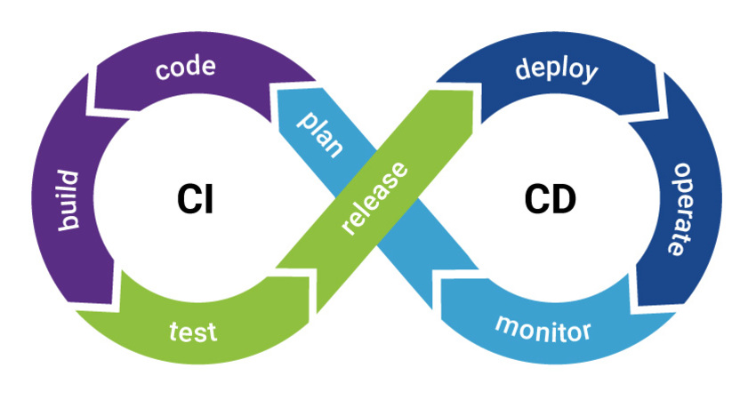


CI/CD and Docker Renovations
CI/CD
Pull Requests now get live deployments at dev-<PR #>.pollbuddy.app
Instances now stored in ZFS volumes for data deduplication (space savings of about 5x)
Added script to shut down instances older than 2 weeks
Added some readme notes
Docker
Lint Mode
Development Mode
Notes:
Presenter: Hunter
As for things that I worked on, my main focus this semester was with CI/CD and Docker.
CI/CD is our automated test instance and production instance deployment system. Some changes this semester are that now pull requests get their own instances too, in addition to the ones per commit. They’re also now stored on a ZFS volume which is a special type of file system that allows for helpful things like data deduplication. Each instance takes around 350MB or so to store when you factor everything in, and all the instances all nearly identical, so this majorly helps to save space on the VM. I also added a shutdown script that runs nightly with cron to check for instances older than 2 weeks and shut down the containers. This has the main benefit of reducing CPU and RAM usage once the instances aren’t likely to be needed anymore. As of right now, we have around 400 containers running, with a few hundred more that are stopped but still stored, so it’s definitely important to have these optimizations.
For Docker changes, the main highlights are splitting the main Docker setup into a Production setup, a Development setup, and a Linting setup. We already had automated code linting set up through GitHub Actions that runs when a pull request is made, but now you can run the linting easily on your local machine so you can know before you create a pull request if you have any code quality issues. The development mode also enables live code reloading when you make changes, without having to stop and restart the entire app like before. This speeds up development a lot when you’re making small changes looking for a specific outcome. Production mode is what runs on the CI/CD server and this optimizes the app like you’d expect for a production environment, but don’t need for development purposes.

Slide 29
Login Cookies
User information is stored in database and can be accessed by cookie session id.
Holds important information such as username and logged-in state.
Notes:
Presenter: Aidan Lane
Used express-session to hold important information in cookies such as username, name and logged in state. User will be automatically logged in if they have logged in, in the past.

Slide 30
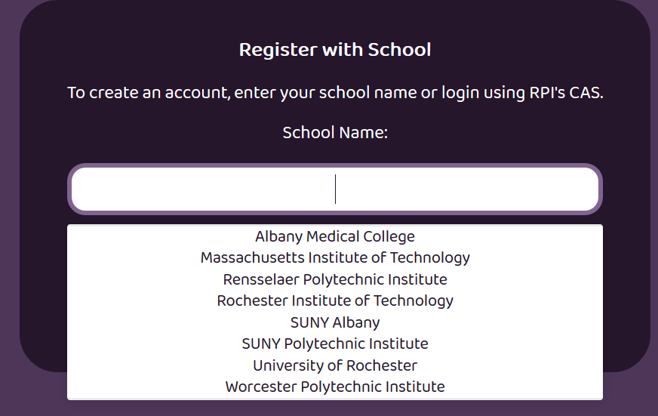
Schools List
https://pollbuddy.app/register/school
Was previously hard-coded
Now populates using API
Dynamic, Expandable system
Each school “adds itself” to the list:
The user will (soon) be given this list to sign in
Currently only supports RPI, but we can (and hopefully will!) add more schools
Notes:
Presenter: Tyler
Talk about old vs new systems
Previously, hard-coded list that you see on screen
Now, there is a list “object” that goes and “collects” the school names.
Each school’s backend file is used to set up connections to CAS or whatever equivalent, and can have a line like so
Currently we only have RPI on this system, but soon we’ll have more and then we can change the register/login pages to use this dynamic list
(point out link, mention it currently uses the hard-coded list as shown, backend integration soon)

Slide 31
Back End Future Goals
Further frontend integration
Further logging/reporting capabilities and graphs
Scaling
Submitty integration
Anti-cheating
And much more!
Notes:
Presenter: Tyler
And here are some of our future goals. First off, we need to finish the frontend/backend integration; it’s still lacking in many areas. As a fun fact, the demo poll was actually made using CURL commands to the backend API directly rather than through the frontend as that’s not ready yet.
Future things we plan to look at are further logging and reporting, scalability/efficiency, integration with Submitty (iClicker points), anti-cheat functionality, and much more.

Slide 32
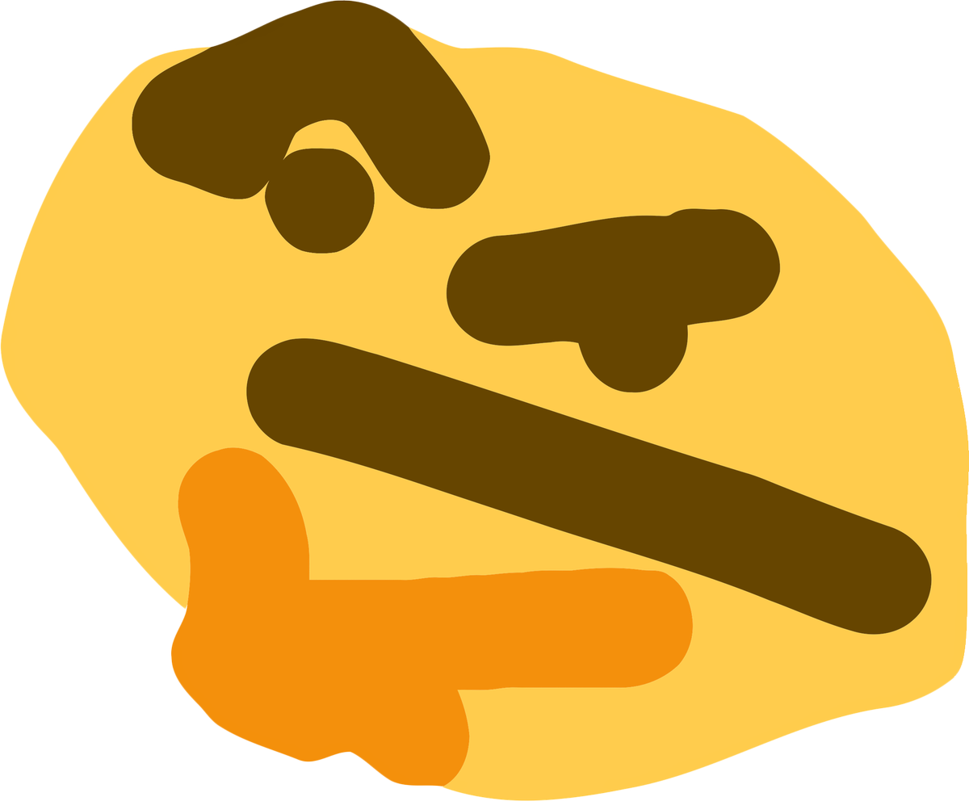
Thank You!
Any Questions?
https://pollbuddy.app/polls/5fc86a9974b9fa7c7b88d2ee/results
Notes:
Presenter: Hunter
This has been Poll Buddy! I also left a link here to the results from the demo poll that people hopefully checked out. Does anyone have any questions?

